Slide 1


Advancing the Geodetic infrastructure in Europe through EUREF
REFAG 2022, 17-20 October 2022, Thessaloniki, Greece.
Martin Lidberg, C Bruyninx, E Brockmann, R Dach, A Kenyeres, K Kollo, J Legrand, T Liwosz, B Männel, R Pacione, M Sacher, J Schwabe, W Söhne, C Völksen, Z Altamimi, A Caporali, M Poutanen, J Zurutuza, J A Torres

Slide 2
Outline
What is EUREF?
EUREF’s primary tasks and deliveries
How to maintain and develop a regional reference frame
On EPN-Repro3
Scientific challenges and strategic goals
Heights, geoid and gravity
Organizational perspective

Slide 3
What is EUREF? –”WHO WE ARE”
“EUREF is the IAG Reference Frame Sub-Commission for Europe, integrated in the Sub-Commission 1.3, Regional Reference Frames, under Commission 1 – Reference Frames”
The Sub-Commission EUREF was founded in 1987 at the IUGG General Assembly held in Vancouver.¹
However, since we also deals with gravity related heights etc., we are somewhat more and take a wider scope and responsibility for geodetic infrastructure (in a broad sense) for Europe.
We aim at continue to being the recognized expert organization on geodesy for Europe.
¹From: http://www.euref.eu/

Slide 4
EUREF’s primary mission and vision
“EUREF’s primary mission is to establish and maintain the European coordinate reference system and physical height reference system”^{1,2}
EUREF’s vision is to serve the European society with homogenous and sustainable geodetic reference frames, height and gravity systems, including data and products, services and tools, based on best available scientific background and taking into account user needs.
¹From EUREF Terms of References 2017
²”physical heights” or ”gravity related heights”

Slide 5
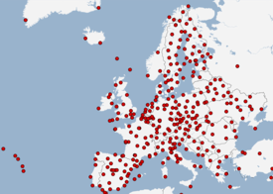
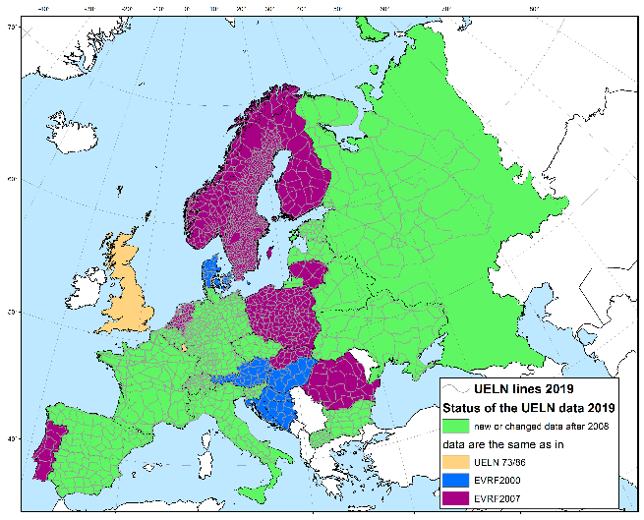
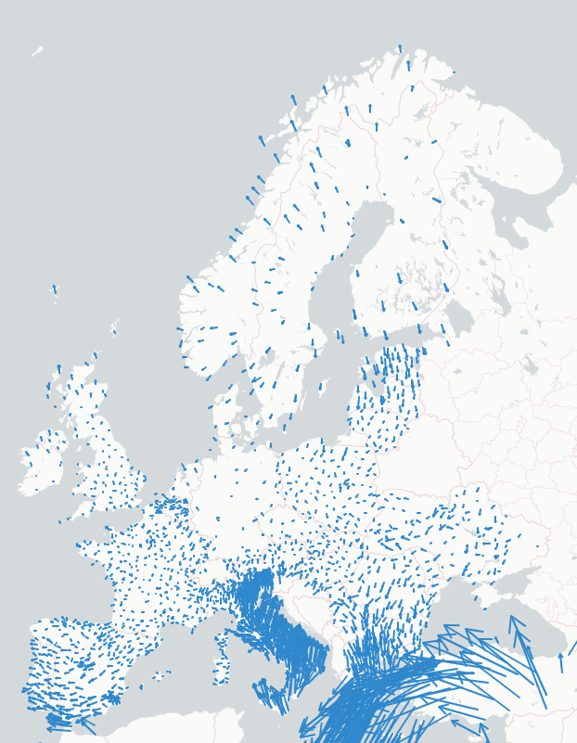
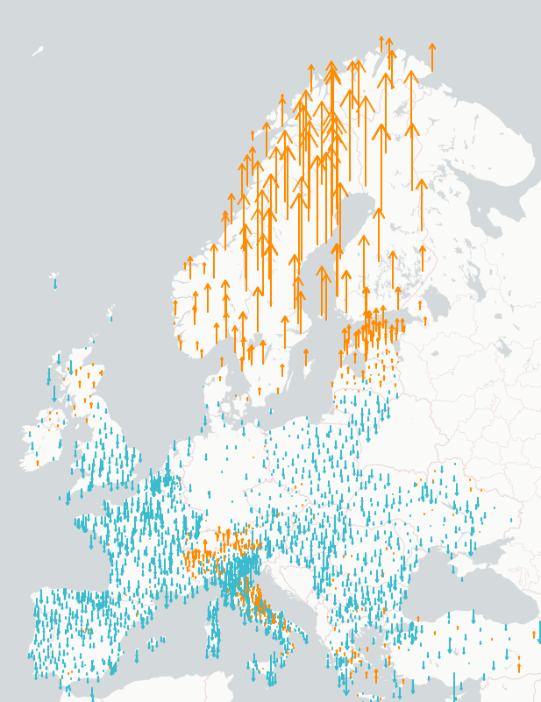


EUREF primarily “products” (well – but there is much more too…)
ETRS89 (European Terrestrial Reference System and Frame)
is available in practically all countries in Europe through national realizations
is maintained and developed through the EUREF Permanent GNSS Network, EPN
EVRS (European Vertical Reference System and Frame)
realized and maintained through the UELN (United European Levelling Network)
Also available in most European countries
ETRS89 and EVRS are mandatory for exchange of geodata under the European Union INSPIRE directive (Infrastructure for Spatial Information in Europe)
Crustal deformations / velocities are monitored through the “EPN Densification” and the “European dense velocities” working groups.
5

Slide 6
European Vertical Reference System and Frame, EVRS/EVRF
EVRS is realized through a common adjustment of available national precise levelling networks that form the United European Levelling Network, UELN
The height reference is the level of Normaal Amsterdam Peil, NAP
The recent realization EVRF2019
  Includes ~14 000 observations
  and ~11 000 unknowns (nodal points)
  Average standard uncertainty close to 1mm/√km
  Reduced to epoch 2000.0 for areas with clear secular velocities where velocity models are available (Fennoscandia and Switzerland)

Slide 7
The European Terrestrial Reference System 1989, ETRS89
The ETRS89 is by its definition coincident with the ITRS at the epoch1989.0 and fixed to the stable part of the Eurasian plate.
In practice it is done by rotating ITRF coordinates back to epoch 1989.0 using a plate rotation model (and possibly a translation to improve consistency to previous realization)
Thus, usually a new European frame is derived when new ITRFs becomes available, e.g.:
ETRF89, ETRF90, ETRF92, ..., ETRF2000, (ETRF2005), ETRF2014
Maintained and developed through the EPN

Slide 8
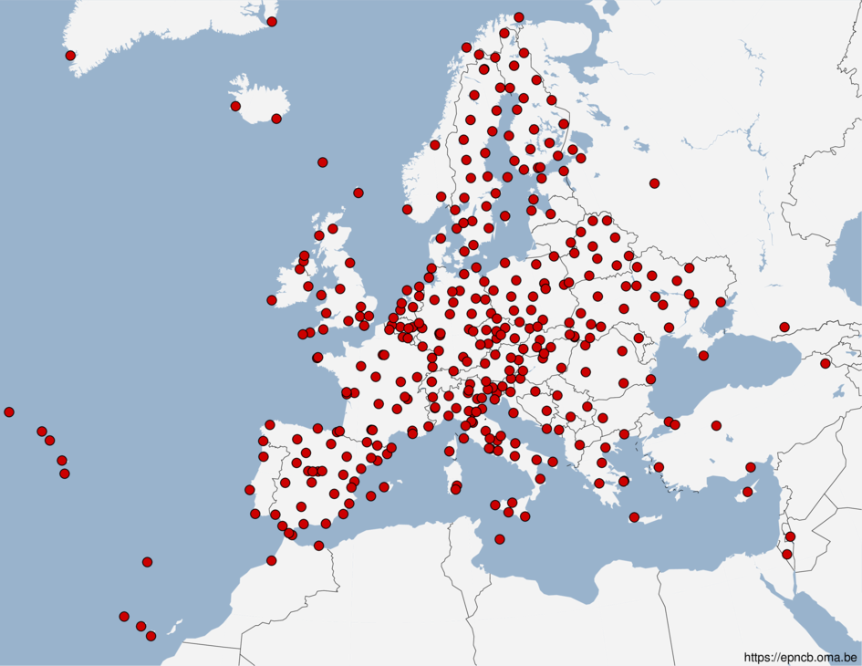
The EUREF Permanent GNSS network, EPN
Started in 1996
More than 370 GNSS stations
Data centers for archiving and providing access to GNSS data
Analysis centers (16) that analyze the GNSS data
Product centers and coordinators that generate the EPN products
A Central Bureau for daily monitoring and management of the EPN
In total more that 100 agencies/universities contributing on “best effort” basis
well defined standards/guidelines for homogenous long-term quality of the EPN products

Slide 9
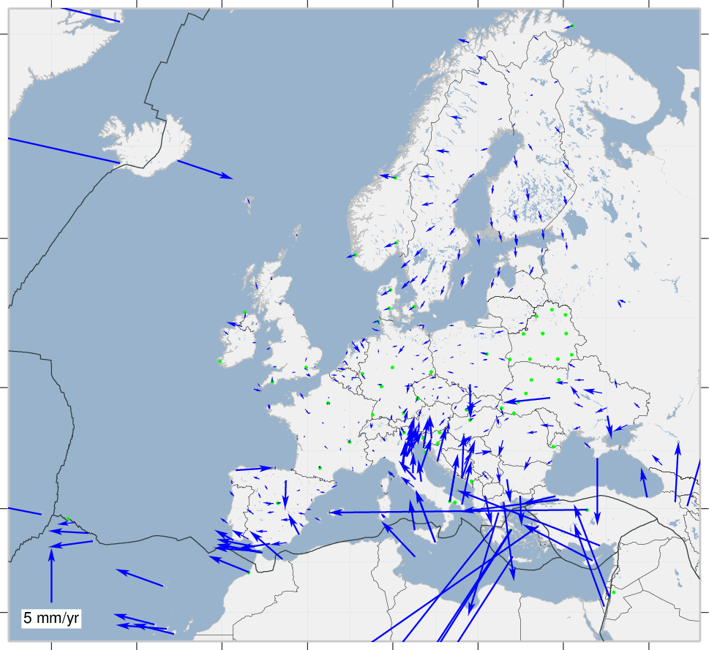
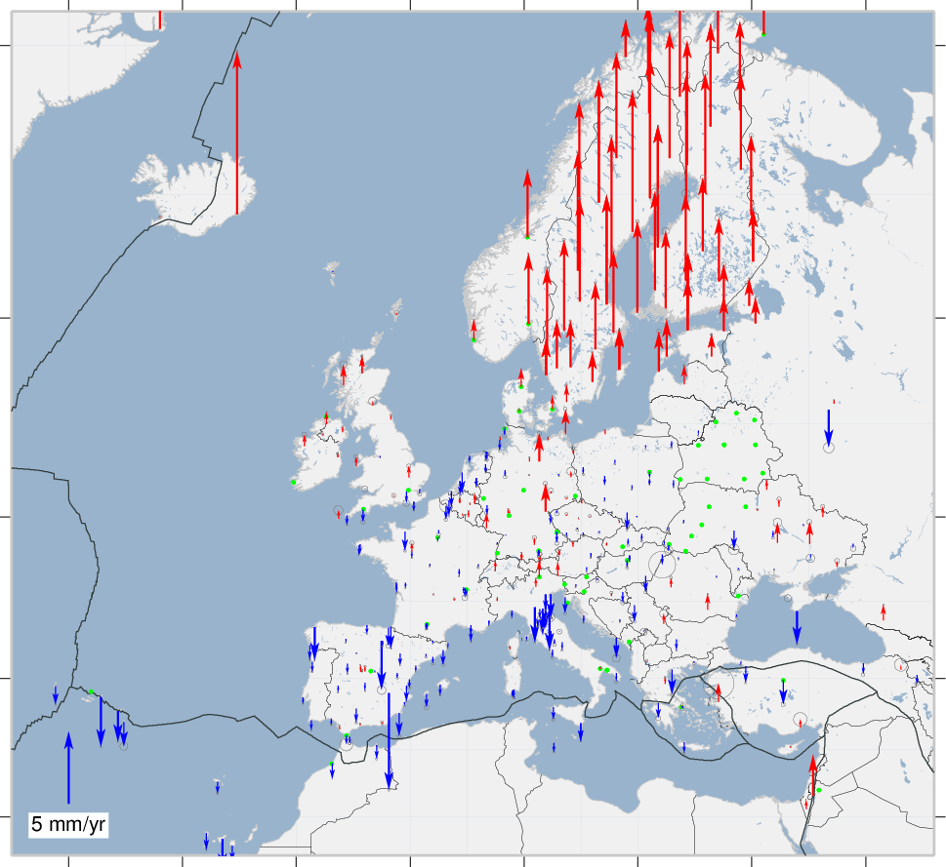
Velocities in ETRS89 (ETRF2014) at EPN stations

Slide 10
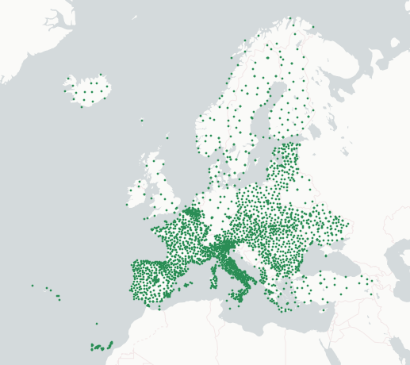
EPN densification, (EPND)
Includes some ten times more stations compared to the core EPN
Daily/weekly station position estimates from dense national or regional GNSS networks delivered in SINEX format (Currently contribution from some 30 agencies)
These are combined into European weekly solutions
After stacking of the weekly solution and time series analysis, the result is one homogenized set of station positions and velocities

Slide 11
EPND velocities

Slide 12
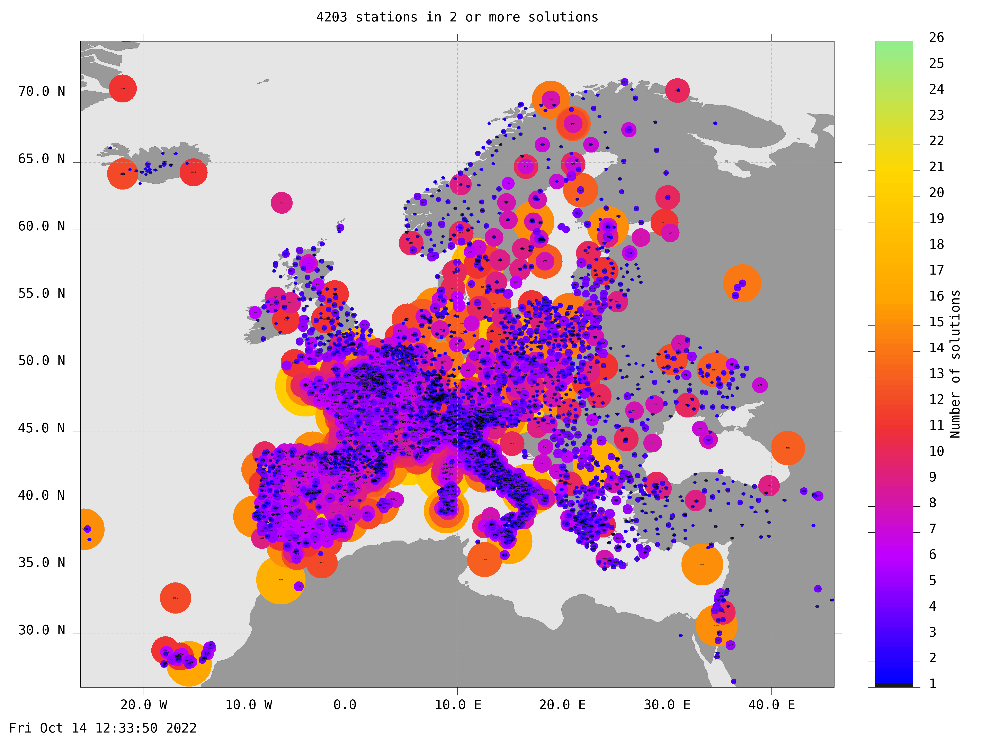
The European dense velocities
Complementary to EPN Densification
Collects regional/local networks of computed GNSS station velocities
Require well defined reference frame (ETRF2000)
Includes today >4000 stations
In EPND, computed daily/weekly SINEX-solution are combined to common European weekly solutions, and then time series analysis and station velocities are derived
In European dense velocities, the philosophy is that station owners know their stations better. Therefore local analysis may provide better internal homogenous results.

Slide 13
EuVeM2022: European Velocity Model 2022 - A 3D Velocity Field Model for Europe
Gridded deformation model derived from GNSS station velocities using collocation methodology
Intended for booth scientific use, as well as for practical geodetic needs (coordinate transformations)
Some steps remains for easy use in coordinate transformations
Presentation by Rebekka Steffen after the coffee-break!

Slide 14
Maintenance of ETRS89 → EPN-Repro3
A geodetic reference frame based on active GNSS stations requires that provided coordinates are consistent with state-of-the-art processing methods and models
Since these methods and models develops over time (and the observing system – the satellite systems – change), maintenance measures are required in order to have homogenous position time series from the active stations, and achieve reliable velocity estimates
Sometimes just coordinate corrections may be sufficient, sometimes complete re-processing is required
Due to the availability of the ITRF2020 and reprocessed orbit and clock products, a consistent reprocessing of the entire EPN from 1996 to the present is considered necessary

Slide 15
EPN Repro1 and Repro 2
EPN-Repro1:
    Period: Jan. 1996 - Jan. 2007 (GPS week 834 - 1408)
    Reference Frame: IGS05; Antenna calibration: epn_05.atx (individual)
    Solutions based on subnetworks (distributed processing) were provided
      Bernese: 14 / GAMIT:2 / GIPSY:2, finalized in 2012
      Strategy for Repro and Operational analysis similar → smooth transition at the change from Repro to Operational in position time series
EPN-Repro2:
    Period: Jan. 1996 - Dec. 2014 (GPS week 834 – 1824)
    Reference Frame: IGb08; Antenna calibration: epn_08.atx (individual)
    5 solutions provided, (3 Full-EPN solutions based on GAMIT, GIPSY and Bernese, plus 2 subnetworks based on Bernese) finalized in 2016
    Reprocessed solutions agreed well, but inconsistencies occurred at transition to operational solutions

Slide 16
Considerations for EPN-Repro3
Consistent analysis between Repro3 and the operational analysis (software and sub-networks)
Antenna Phase Center Variation/Offset (PCV/PCO) models: individual or type-mean?
EPN has applied individual calibrations where available
For proper reference frame realization (to “igs2020”), consistent analysis with IGS is beneficial/required
Existing individual calibrations may not include “new” GNSS frequencies (Multi frequency GNSS) → see next slide
Conclusion: type mean antenna models preferred!

Slide 17
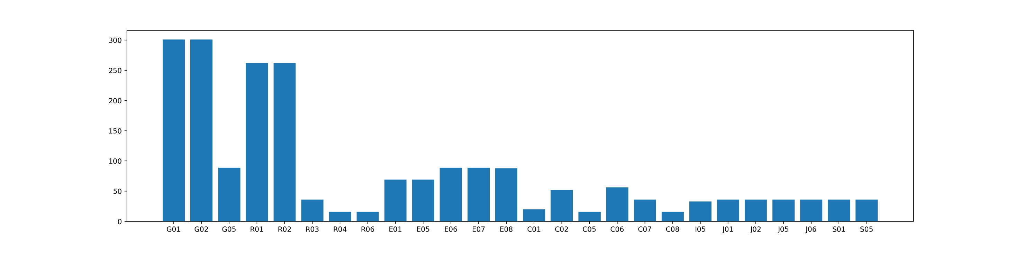
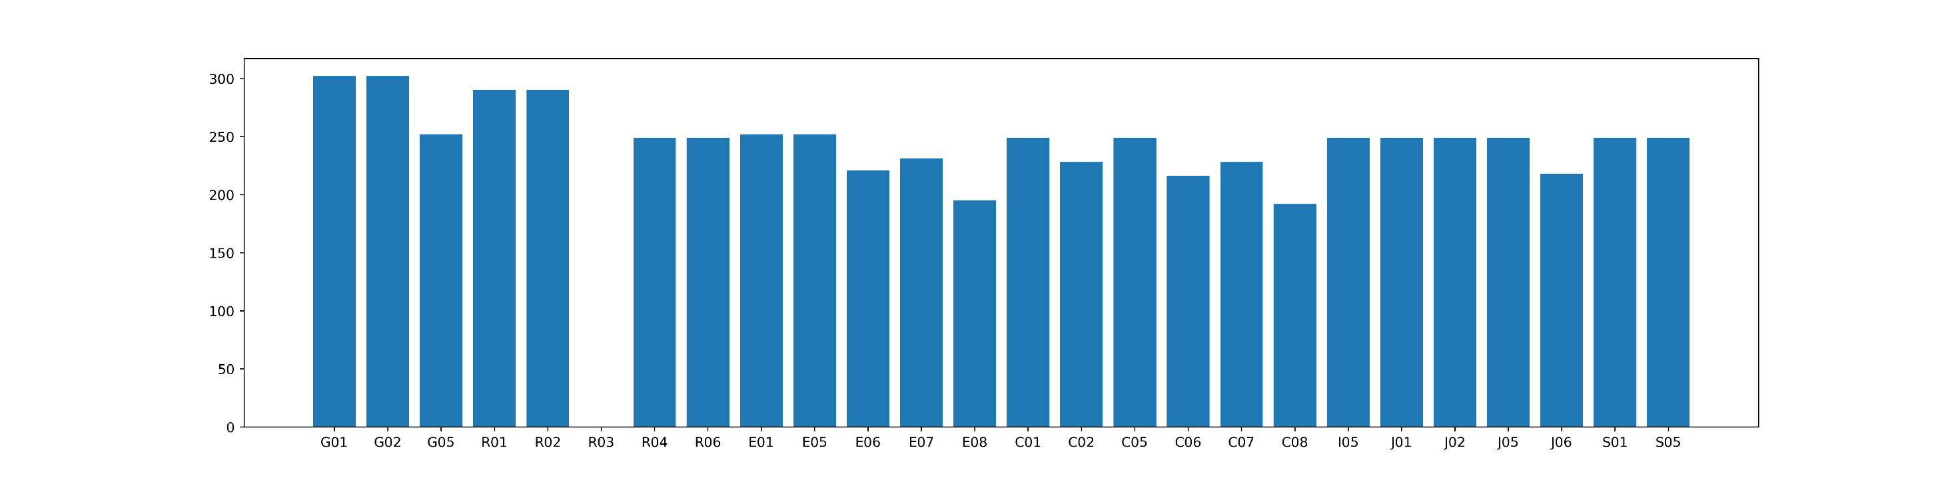
308 Individual Antenna Calibrations available @ EPN CB provided by J. Legrand
⇒ 42 different antenna/radome types
GPS
GLONASS
GAL
Calibrated Frequencies from the Individual Antenna Calibrations available @ EPN CB
# of calibrations for each frequency
Calibrated fre-quencies from the file igsR3.atx for the same antenna/radome types

Slide 18
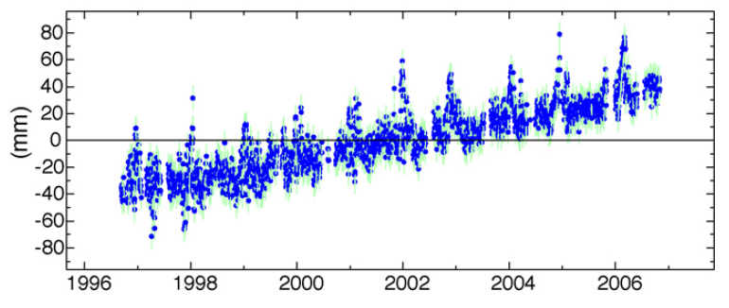
Test of combining the Regional EPN with Global IGS
Regional networks may suffer from “edge effects” at the outer regions of the network
The EPN also includes areas affected by Glacial Isostatic Adjustment (GIA), and “winter effects” (snow on the antenna) at these outer areas (Fennoscandia, Iceland, Greenland)
Reliable stations for reference frame realization may therefore be difficult
Global analysis have been discussed, but it requires a lot of efforts, and is basically the task for the IGS
But consistent analysis between EPN and IGS (consistent antenna models) may provide possibilities to perform daily combined solutions between EPN and IGS
Thus making global reference frame alignment possible
So, let’s try!

Slide 19
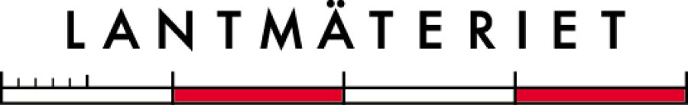
Test of global alignment of the NKG EPN solution (one of the EPN Analysis centers)
Tobias Nilsson, Tina Kempe, Martin Lidberg
Lantmäteriet, Sweden

Slide 20
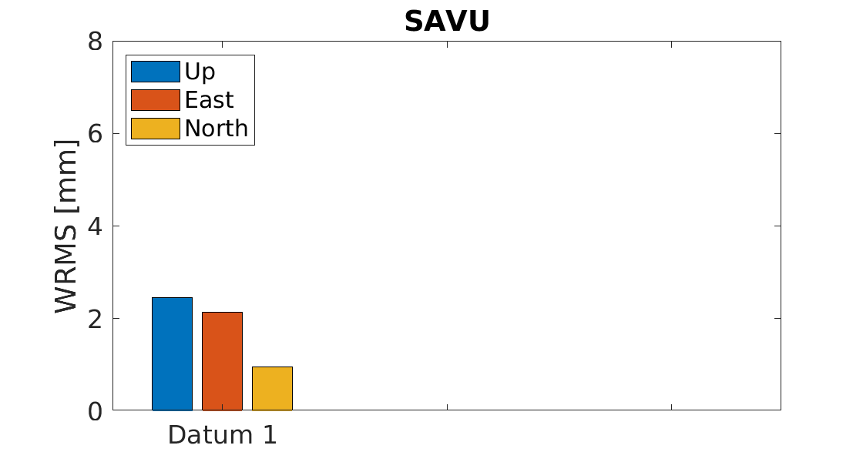
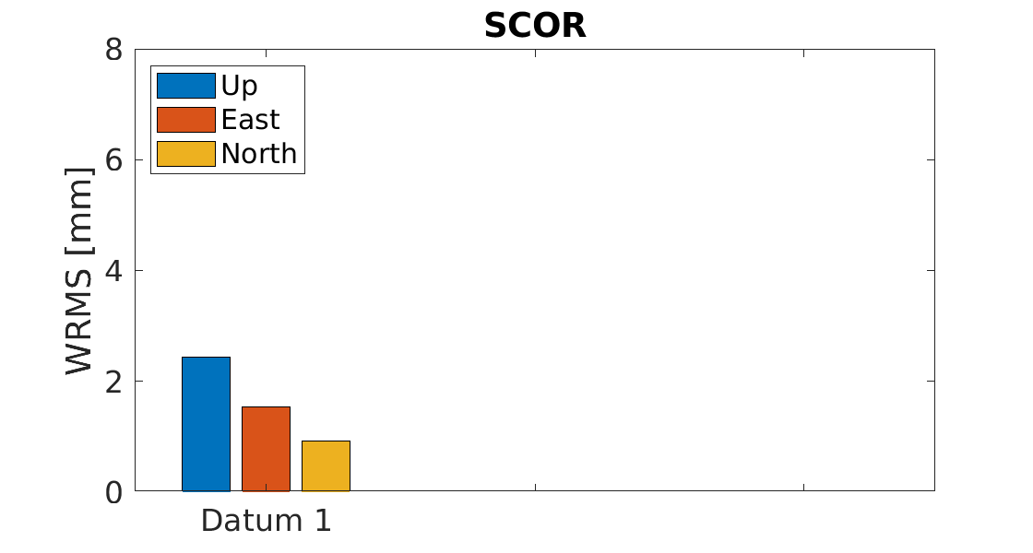
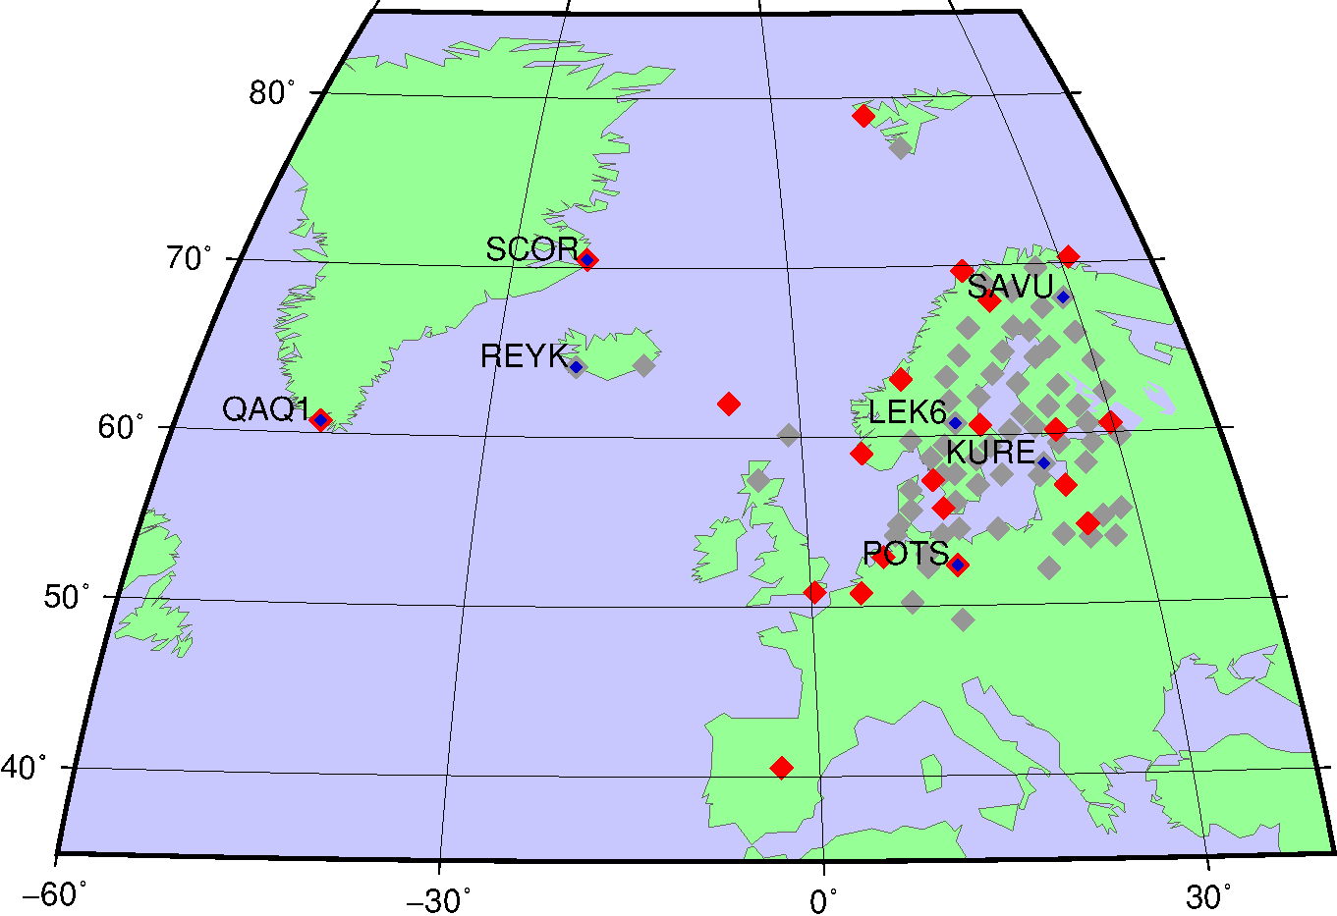
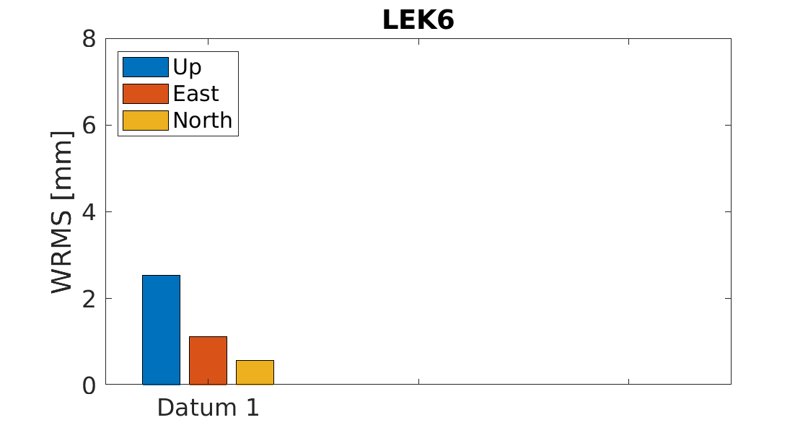
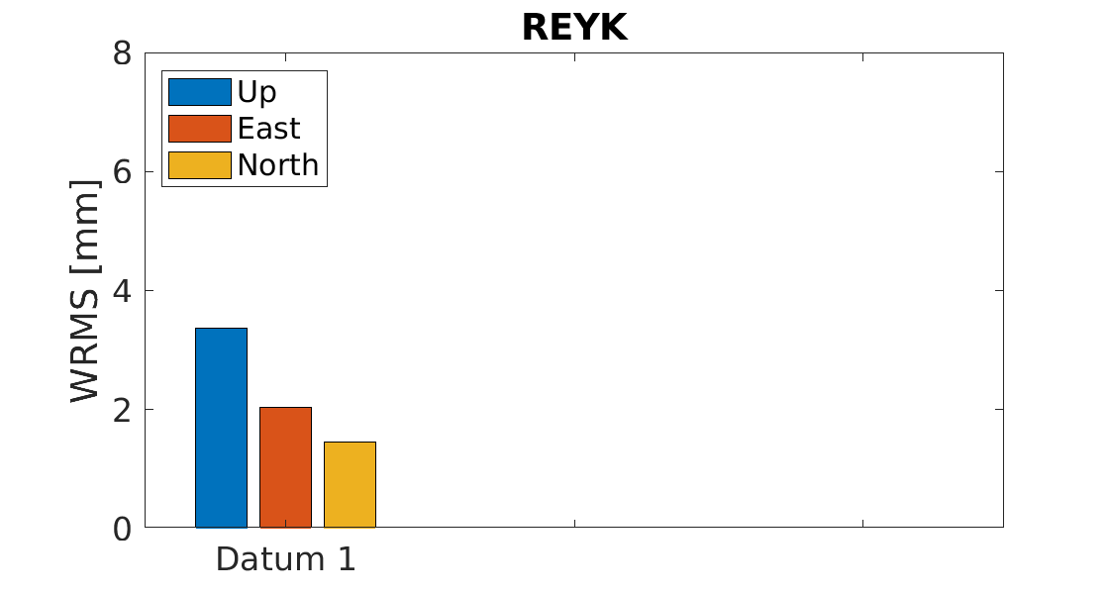
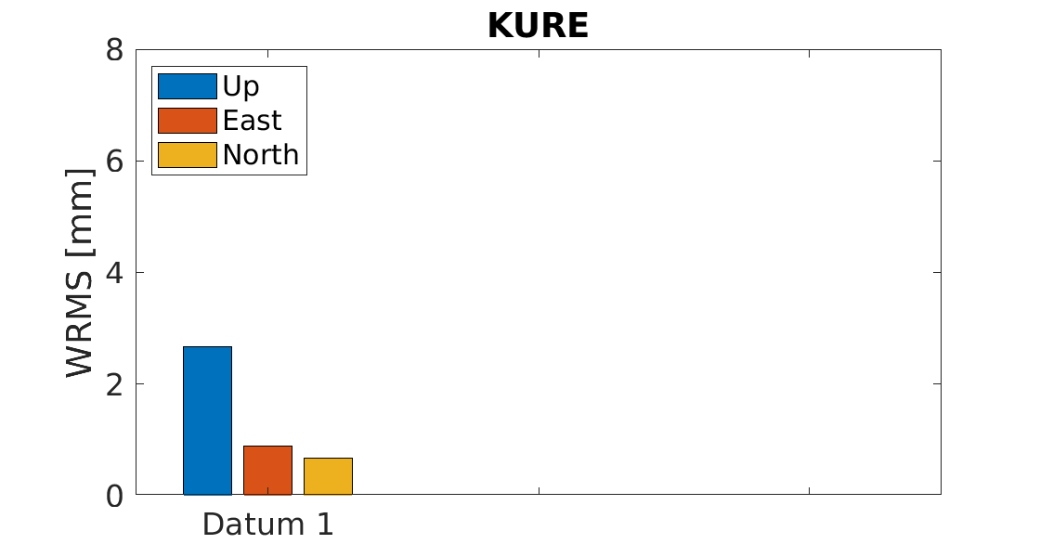
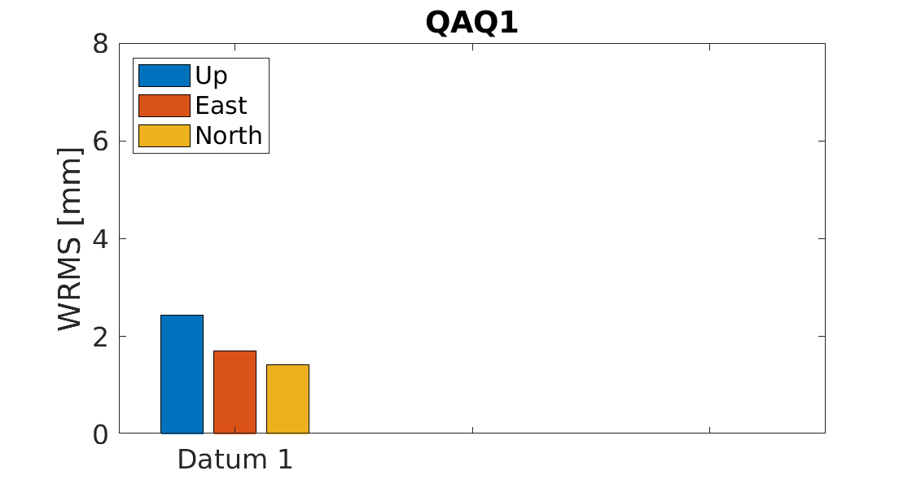
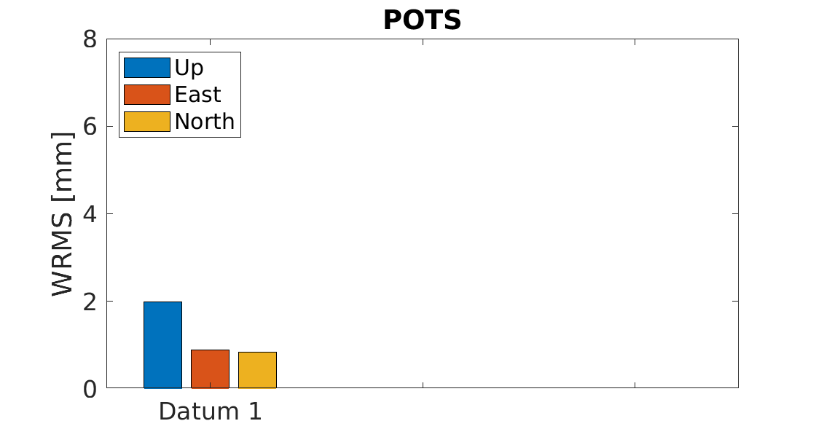
DatuM 1: well distributed
Time period: 20 February to 21 May, 2022. ~100 days
Station not in datum
Datum station

Slide 21
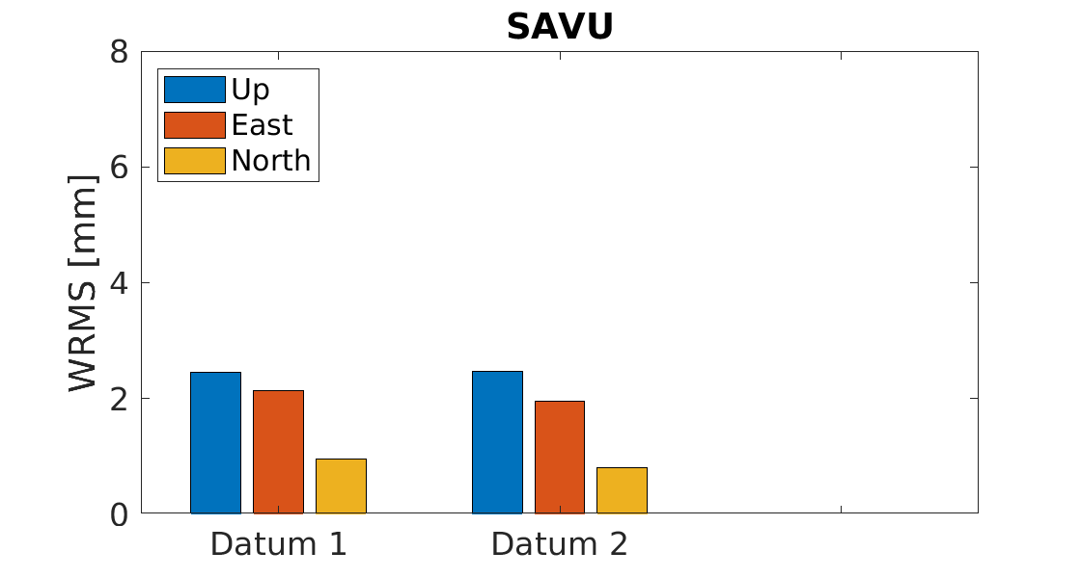
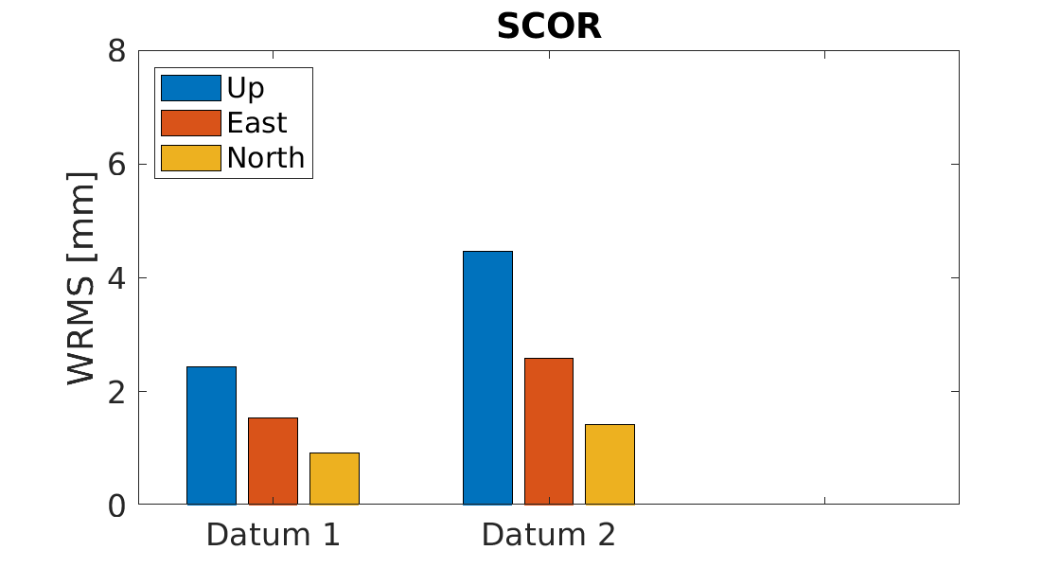

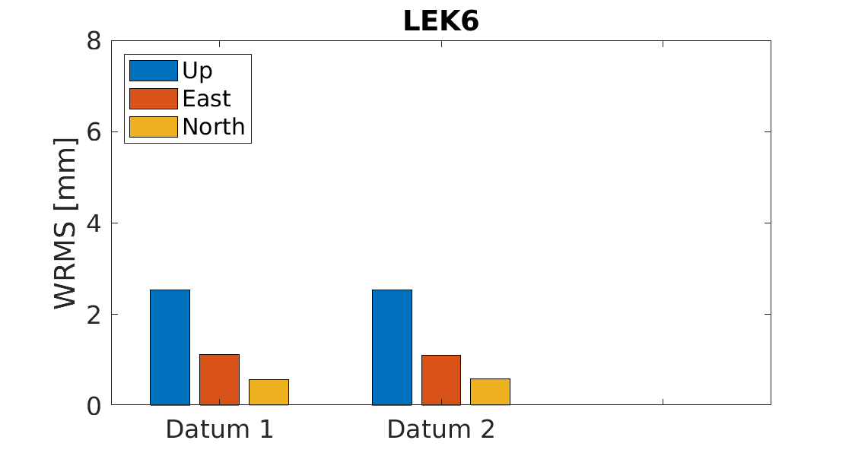
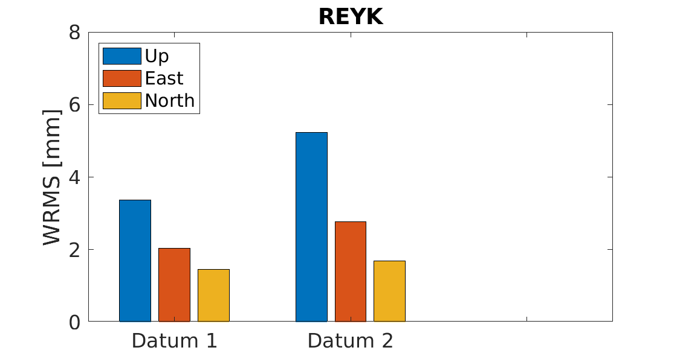
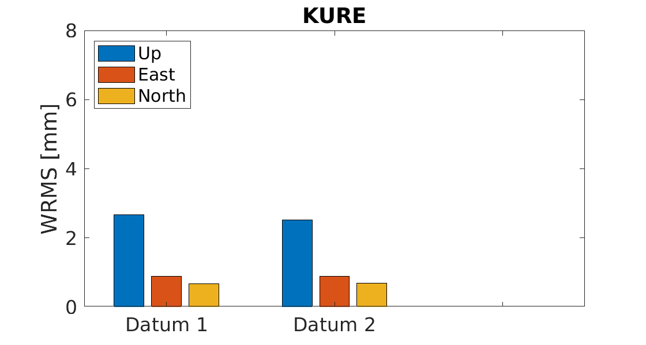
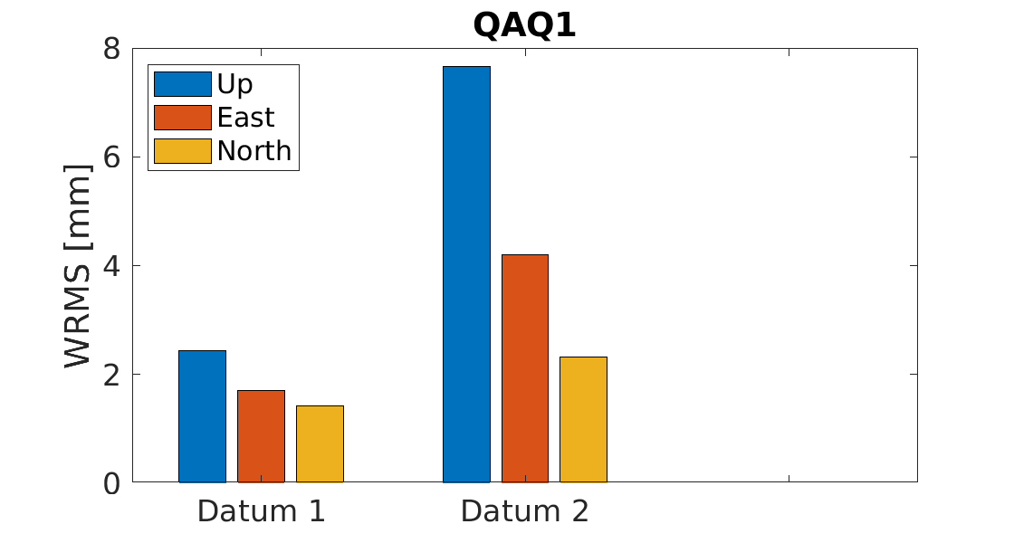
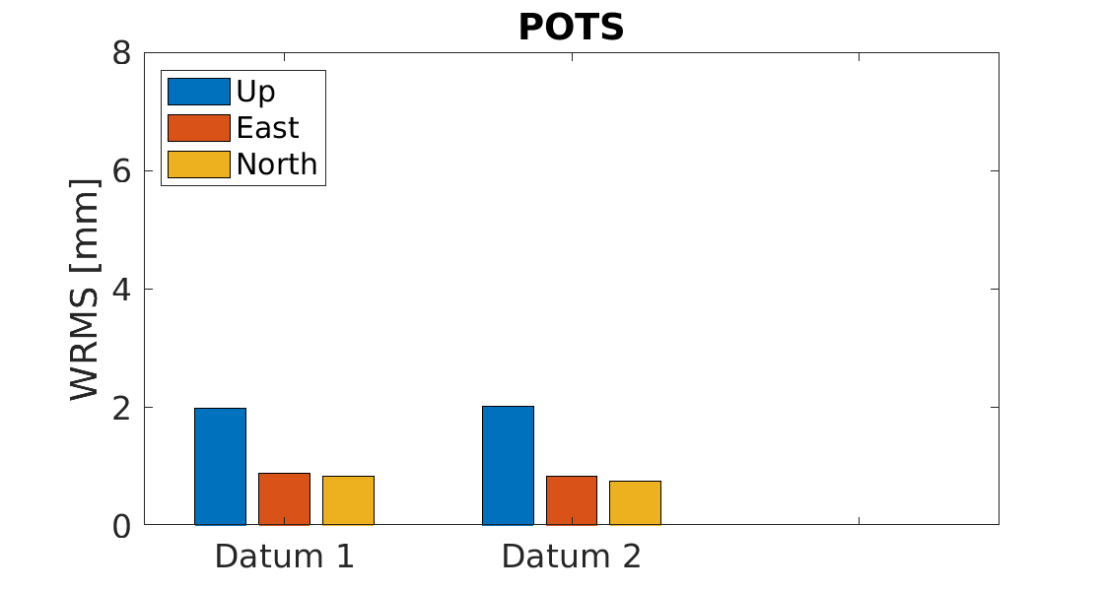
DatuM 2: Without greenland
Time period: 20 February to 21 May, 2022. ~100 days
Worse results in Greenland and Iceland, otherwise no effect

Slide 22
Global alignment
For global alignment, it is important that the regional and global solutions are consistent
We tested combining the NKG EPN solution with the global CODE rapid solution
  Both solutions use GPS+GLONASS+Galileo
  Both are produced with the Bernese software
  Analysis settings are relatively similar
  Several common stations
One important difference:
  Operational NKG EPN solution uses individual antenna calibrations (when available)
  CODE only use type mean calibrations
  To be consistent, we reprocessed the NKG EPN solution for the period 20 February-21 May, 2022, using type mean antenna calibrations
Combination and datum realization done with CATREF

Slide 23
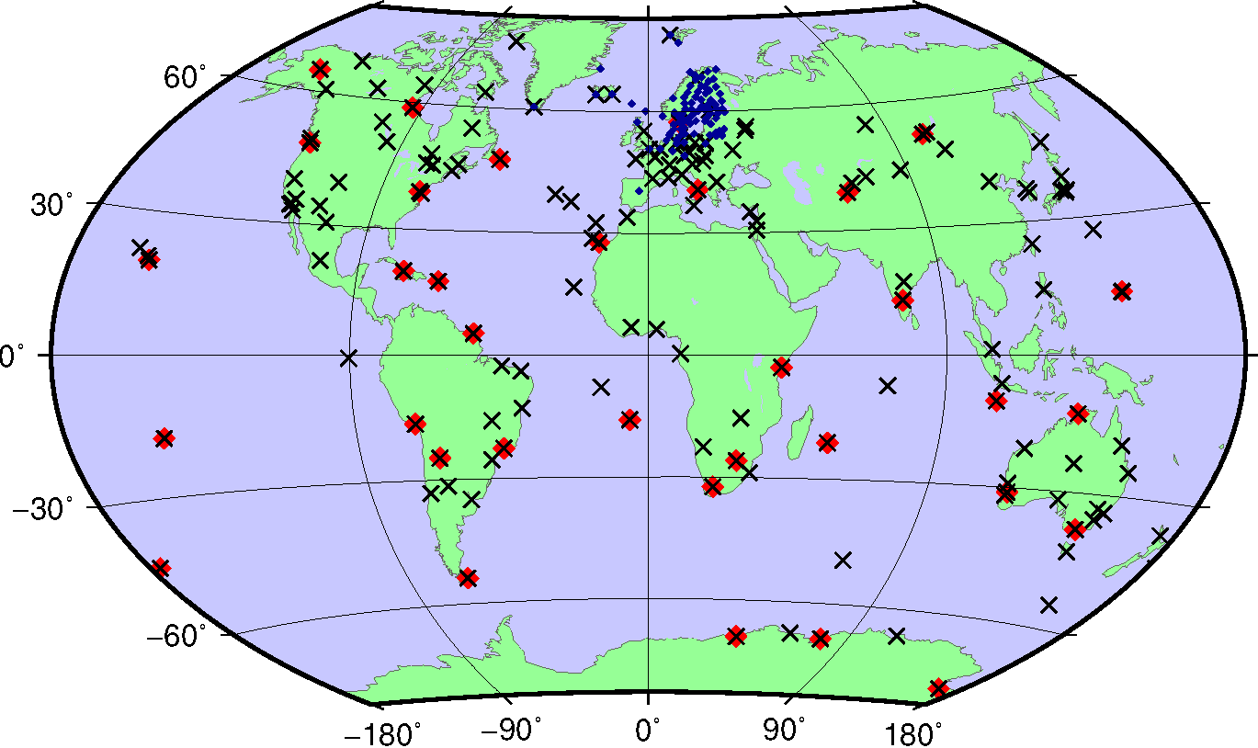
Global datum
CODE stations
NKG stations
Datum station

Slide 24
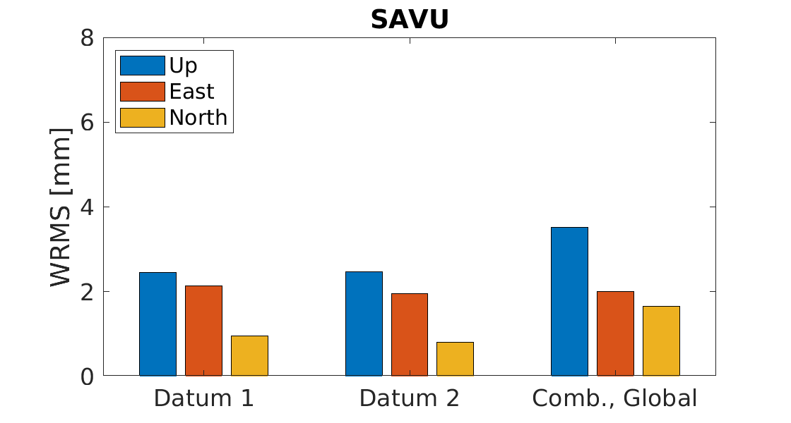
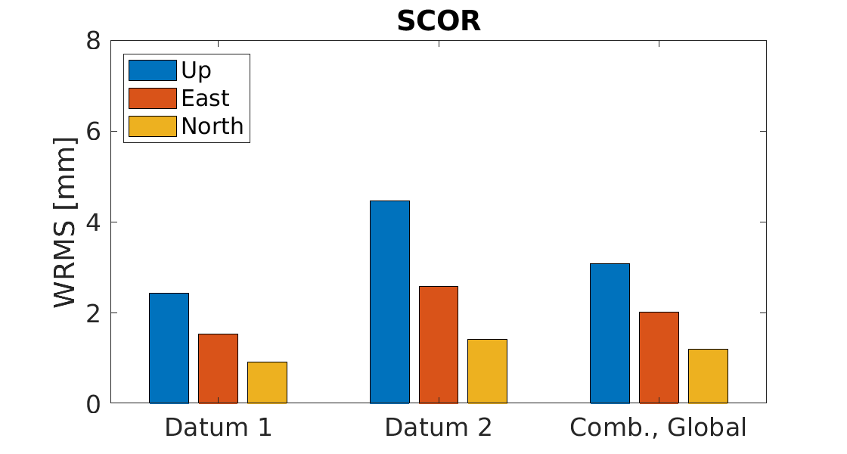
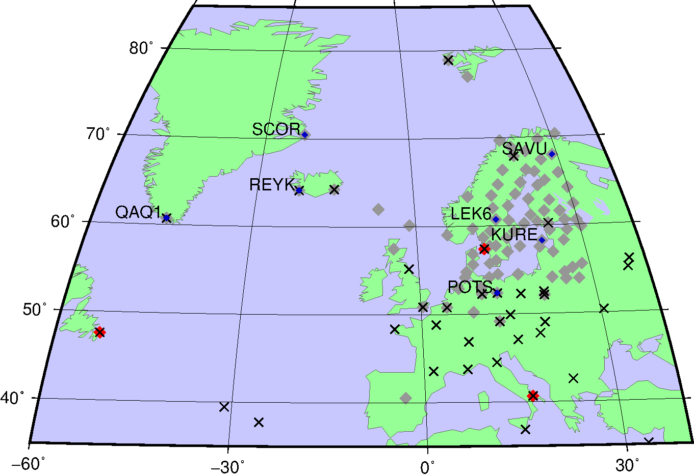
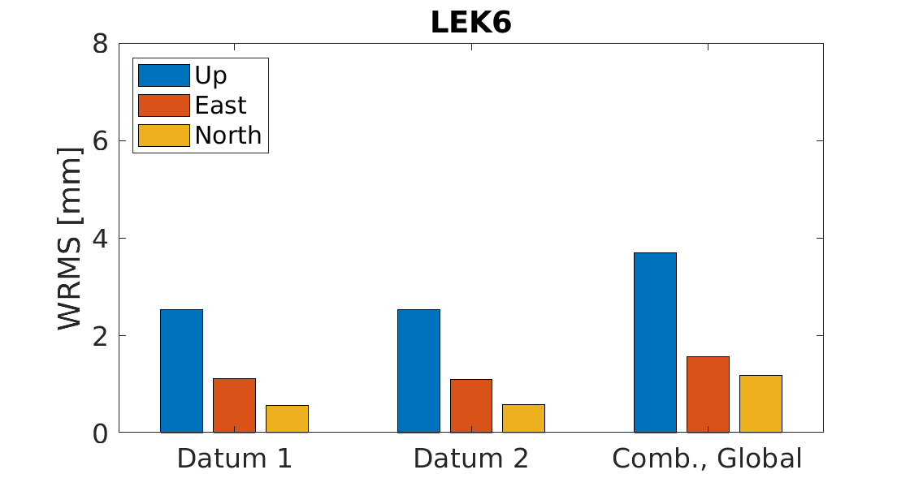
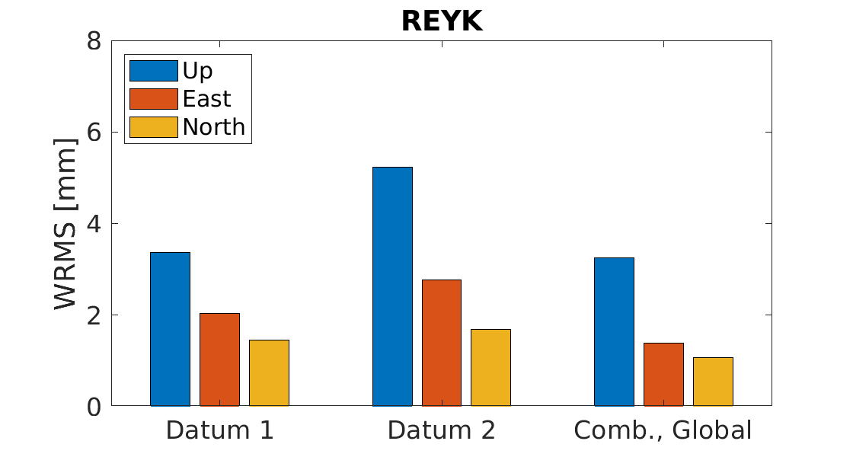
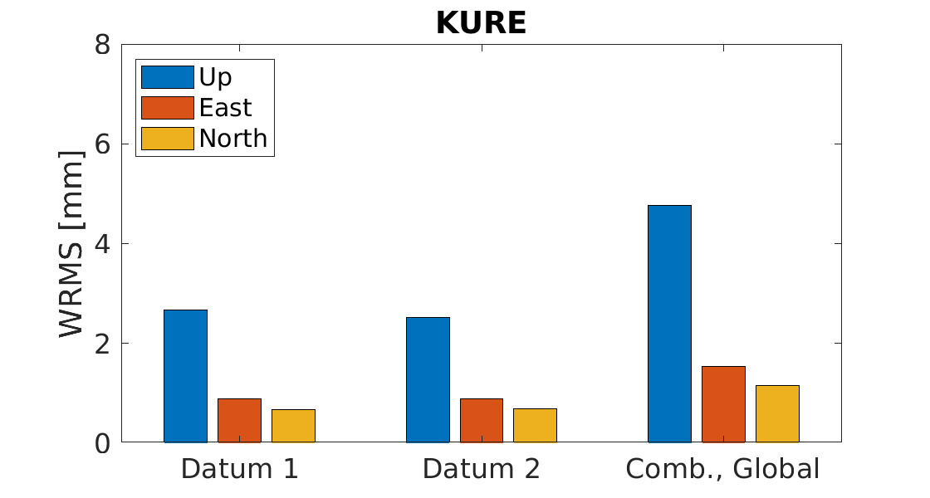
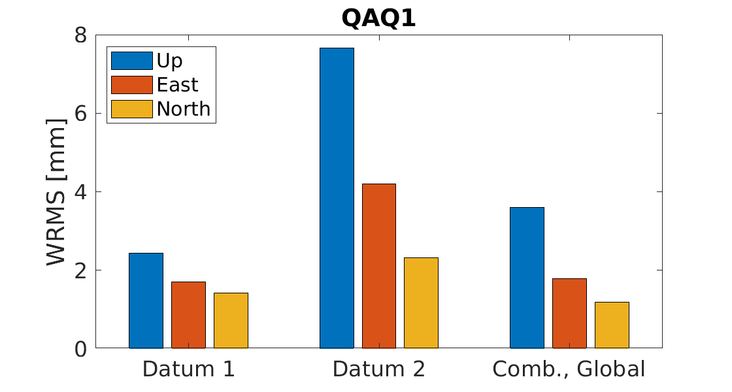
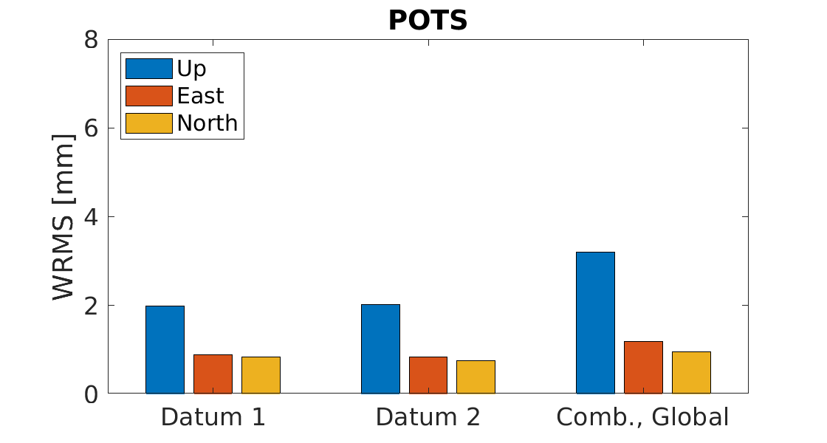
Combined solution: global datum
Time period: 20 February to 21 May, 2022. ~100 days

Slide 25
Very preliminar conclusions
This was just a first test..
Applying a regional datum can lead to significant effects on the edges of the network
  Especially if there are no datum stations close to the edge
With a global datum, the station position repeatabilities will be slightly worse compared to using a regional datum
However, the performance is similar for all stations (i.e., no edge effects)
  A global datum is probably most interesting when analyzing long time series when long-term stability is more important than short-term repeatability
  However, absence of useful “datum stations” may require an extended network!

Slide 26
Outline
What is EUREF?
EUREF’s primary tasks and deliveries
How to maintain and develop a regional reference frame
On EPN-Repro3
Scientific challenges and strategic goals
Heights, geoid and gravity
Organizational perspective

Slide 27
List of scientific challenges in geodesy 1(2)
As a basis for the strategic considerations on future development, it is good to have a common view on current and coming challenges. These may be of various kinds – scientific, administrative, organizational, technical, and external changes. We in the EUREF GB have worked on the scientific challenges in geodesy from a broad perspective. Therefore, some of the discussed challenges go beyond the immediate responsibility of EUREF.
The global goal of 1 mm and 0.1 mm/yr for ITRF is not met yet. For EUREF it is an important piece in order to improve the consistency and accuracy of the ETRF;
Realization of the IHRS (International Height Reference System) in IHRFs at the 1 cm level or better globally. It means that we from EUREF should realize the IHRF within Europe and establish precise, and well defined, relations between IHRF and recent releases of the EVRF;
Realize the European geoid model at the “half centimeter” uncertainty level at dense spatial resolution;
27

Slide 28
List of scientific challenges in geodesy 2(2)
Develop European models of intraplate velocities and crustal deformations at the sub-mm/yr and nano strain/yr uncertainty level for the purpose of reference frame management and use, as well as increased scientific understanding of underlying geophysical processes;
Contribute with quality checked time series of observations and analysis results for climate monitoring and research (the GNSS technology and its infrastructure is approaching 3 decades, which is the time period where change in atmospheric conditions can be considered as “climate change”)
4D geodesy: the presence of several GNSS implies the introduction of respective time scales which are not necessarily synchronous with each other. Hence the challenge is to define the temporal frame with similar criteria as for the spatial frame;
Frontiers in Geodesy: Geodesy and General Relativity are tightly connected. Hence the challenge to embody the geometric approach to gravity into the definition of reference frames. Gravity dependent scale factors on time and length are first measurable consequences

Slide 29
Gravity related heights, EVRS, IHRS, geoid and gravity
…an area of enhanced ambitions from EUREF…
EVRS¹ is the recognized gravity related height system for Europe and activities on UELN² and the realization of EVRS into EVRF³ continues
the establishment and realization of IHRS⁴ into IHRF⁵ have been of high priority within IAG in recent years, and progress has been fundamental. IHRS should therefore be realized in the EUREF area of interest, and a well determined relation between IHRF and EVRF should be established,
Access to the vertical reference frame are usually done through GNSS-RTK services and a “geoid model”. The realization of the European (quasi-) geoid model (or height reference surface, HRS) at the “half centimeter” uncertainty level at dense spatial resolution is therefore of strategic importance.
This would benefit from a robust dataset of points with booth ETRS89 and EVRS realizations (GNSS-levelling). The review and update of the EUVN-DA⁵ may therefore be considered.
EUREF w.g. ”European Unified Height Reference
1,3. European Vertical Reference System and Frame, 2. United European Levelling Network, 4,5. International Height Reference System
and Frame, 5. European Unified Vertical Network – Densification Act
29

Slide 30
The relations EVRF & ETRF v.s. national VRF & TRF
…and possibly also deformation model
The European height reference surface (quasi geoid model) will be a complementary tool to national geoid/quasi geoid models
Figure from Joachim Schwabe, BKG

Slide 31
Organizational perspective
We see an emerging organizational landscape where e.g. the European Plate Observing System (EPOS) has entered its pre-operational phase, progress is reported from UN-GGIM Sub-Committee of Geodesy (SCoG) and the establishment of a Global Geodetic Center of Excellence (GGCE) hosted in Bonn, Germany, UN-GGIM:Europe develops, EuroGeographics have worked on a revised strategy, also E-GVAP and EUPOS etc.
In this context,
EUREF’s ambition is to continue as a recognized expert organization on geodetic infrastructure and geodetic reference frames for Europe,
cooperation are welcomed in order to facilitate progress in areas where we have mutual interests and for the benefit of the wider user society,
cooperation may be formalized through memorandum of understanding (MoU)
EUREF is not a legal entity and has no plans to establish such a structure.

Slide 32
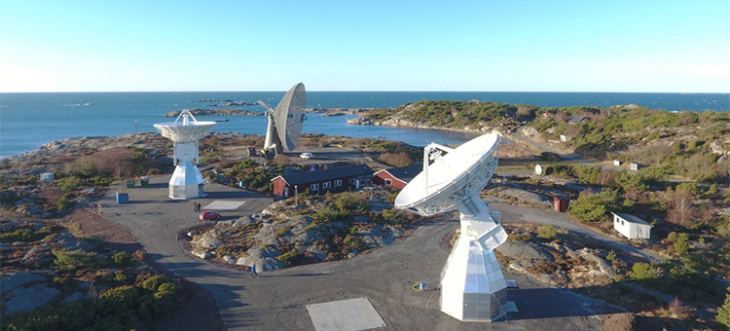
Thanks for your interest!
Martin.lidberg@lm.se

