Slide 1
Transition from PSAD56/SAD69 to SIRGAS.
Toward a kinematic reference frame for mining in Chile
José Antonio Tarrío Mosquera^{1x}, Jesarella Inzunza Muñoz¹, Catalina Caceres Venegas¹, Marcelo Caverlotti Silva¹ ,Valeria Vásquez Tejo¹, Fernando Isla Rodríguez¹, Gabriel Jeldres², Rodrigo Urrutia², Cristian Mardones²
¹Centro de Procesamiento y Análisis Geodésico USC
Universidad de Santiago de Chile
²Servicio Nacional de Geología y Mineria. Chile
IAG International Symposium on Reference Frames for Applications in Geosciences (REFAG 2022), Aristotle University of Thessaloniki,
Commission 1,International Association of Geodesy (IAG). Thessaloniki, Greece on October 17-20, 2022

Slide 2
Table of Contents
Chilean Mining
The context
The problematic
Datum Update Project: Transition from PSAD56-SAD69 to SIRGAS(REDGEOMIN). LAW 21240.
Transitioning from classic reference frame (RF) to modern RF, from static RF to a kinematic RF
Geodetic Networks: Primary(active) and Secondary(passive)
Deformation model: ADELA (Analysis deformation beyond the Andes 2009-2022)
Transformation parameters
Next steps. Implementation
Notes:
Modificar

Slide 3
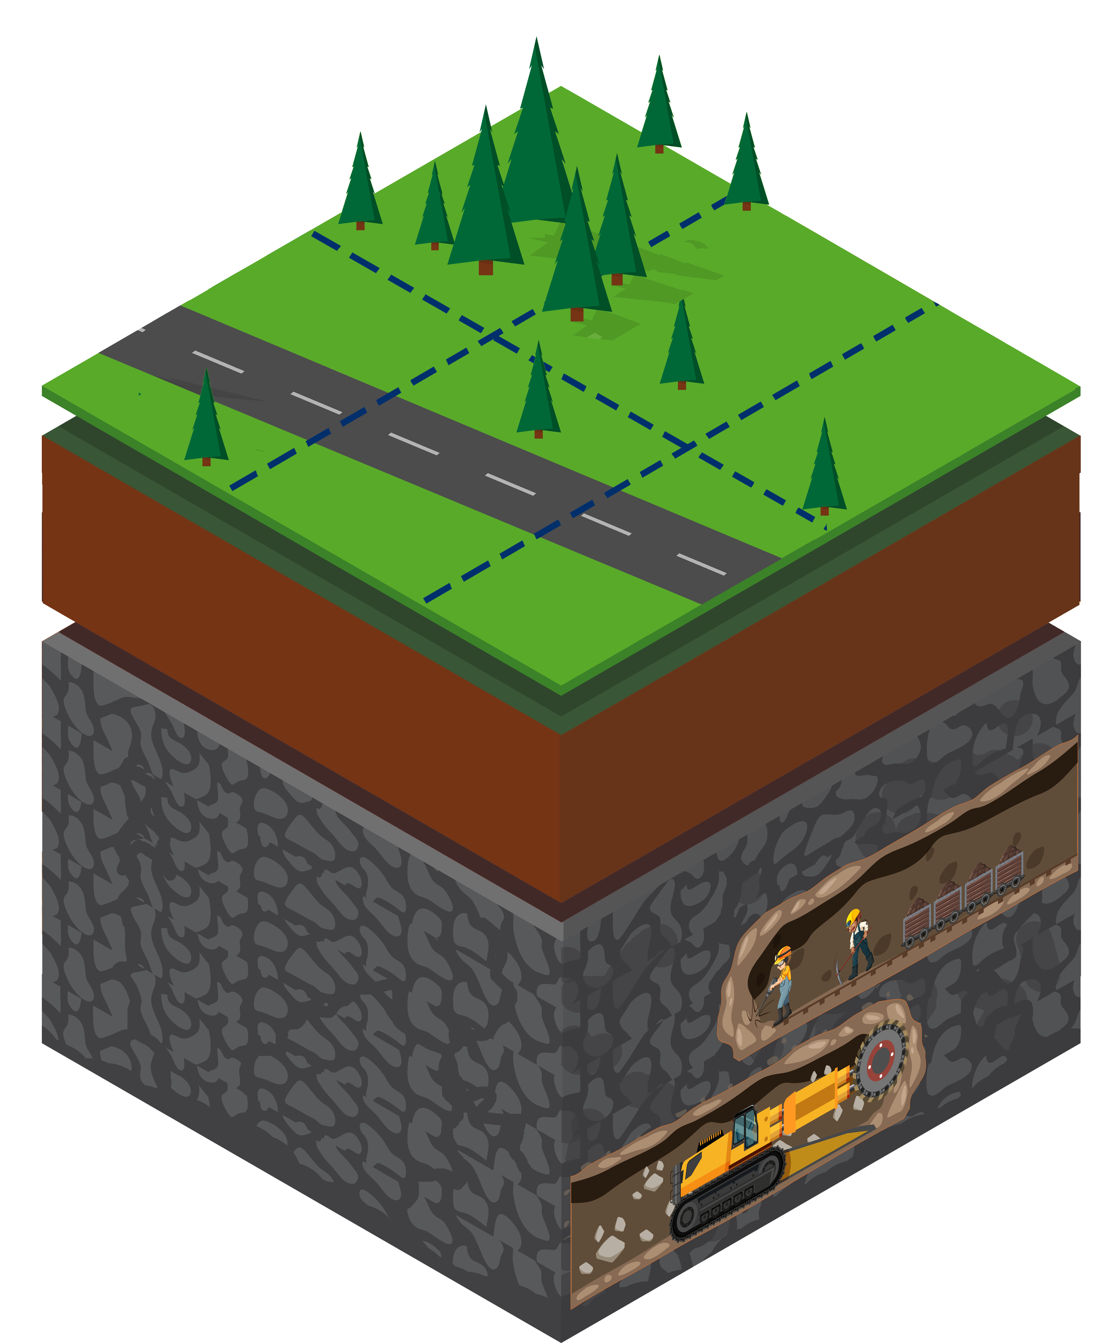
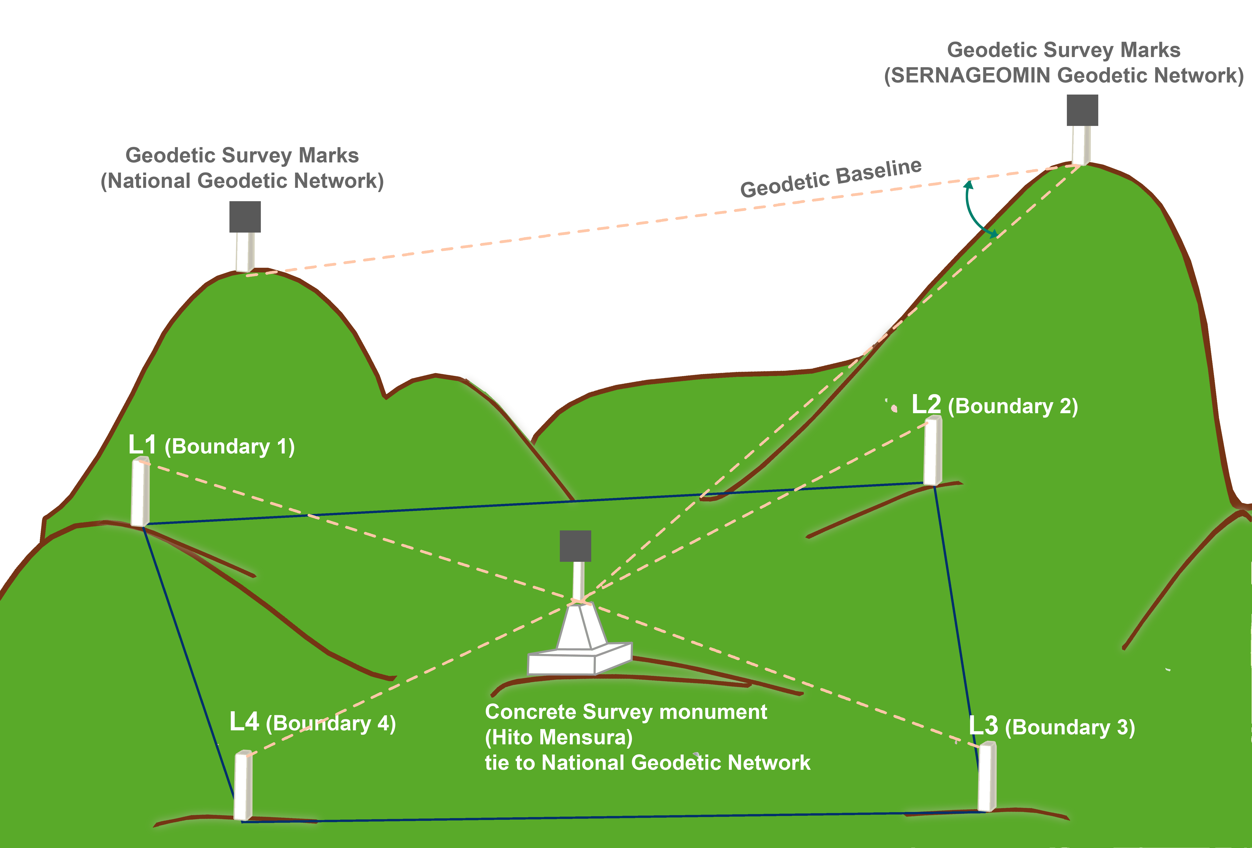
Chilean Mining. The context
The Constitution of 1980 (article 19 number 24 paragraph 6) establishes that the "State has the absolute, exclusive, inalienable and imprescriptible domain of all mines ...".
However, it indicates the possibility of concessions land to explore and extract minerals. This procedure is carried out through ordinary courts of justice (Civil Court of Letters) and not through an agency with technical competence.
Servicio Nacional de Geología y Minería de Chile (SERNAGEOMIN), in English, National Service of Geology and Mining of Chile. Mission: Assistance to the Courts in granting exploitation concessions and applications for the constitutive judgment of mining exploration concessions. Also, to maintain the updated cadastre of mining concessions. The current concessions’ shape is rectangular and oriented according to the UTM grid.
Land’s surface (Public or private)
Subsoil (Chile property)
Fuente: Rodrigo Urrutia et. al. 2018 modified
Notes:
Modificar

Slide 4
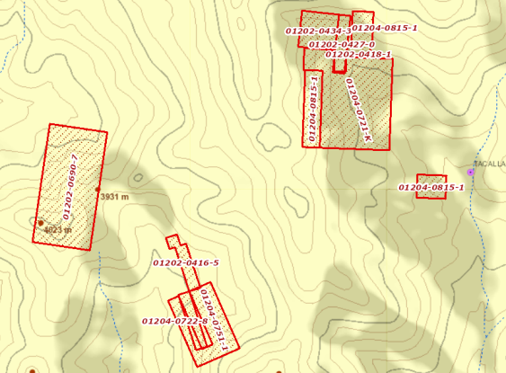
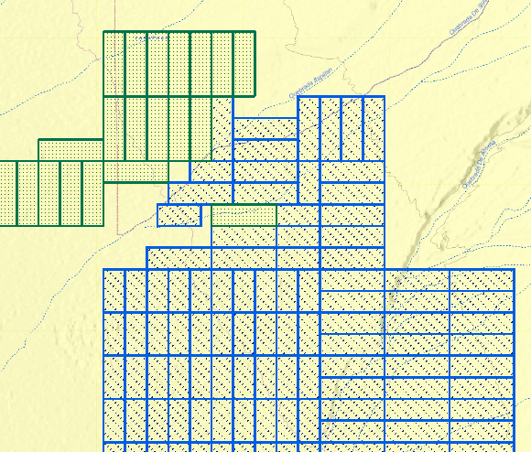
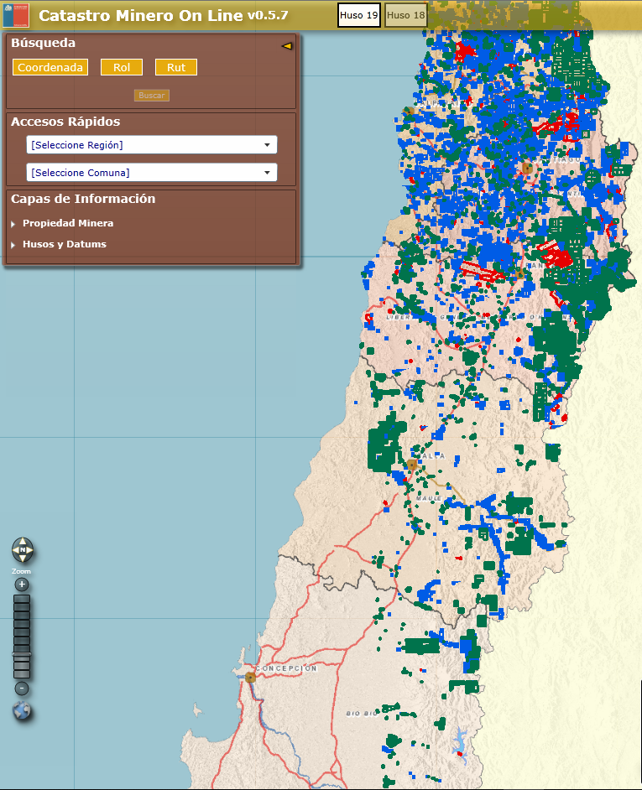
Chilean Mining. The context
The Mining Code (Código de Minería) of 1874, 1888, 1930 and 1932 worked in arbitrary coordinates, with magnetic or astronomical orientations, which resulted in uncertainty as to the location of the concessions, even originating overlaps that were very difficult to detect in time. la ubicación de la concesión.
Mining Code 1874
Mining Code 1888
Mining Code 1930
Mining Code 1932
North UTM
West UTM
Including the UTM Coordinates in the MC of 1983 partly solved the problem. Still, to give a definitive solution, the concessions constituted under the previous legislation needed to be also determined in these UTM Coordinates. As a result of the above, the National Cadastre of Mining Concessions was born in the reference system PSAD56 Provisional South American Datum 1956 (north to -43º30) or SAD69 South American Datum 1969 (-43º30 to south) according to the location of the concession.
Notes:
Modificar

Slide 5
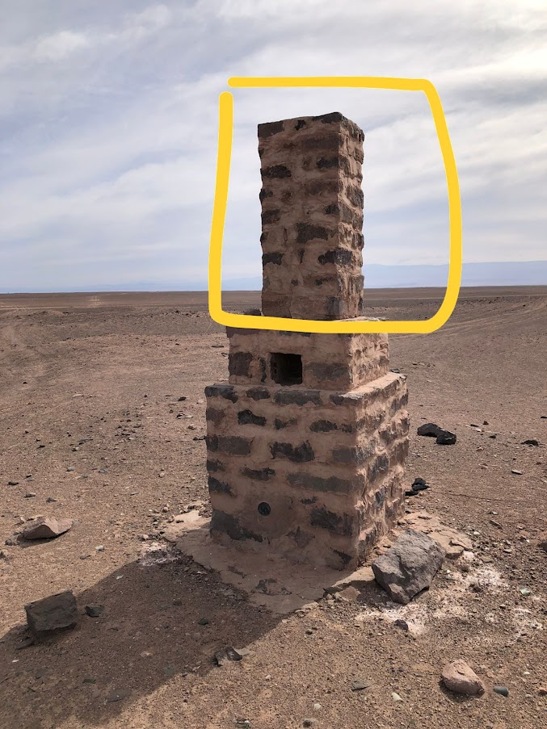
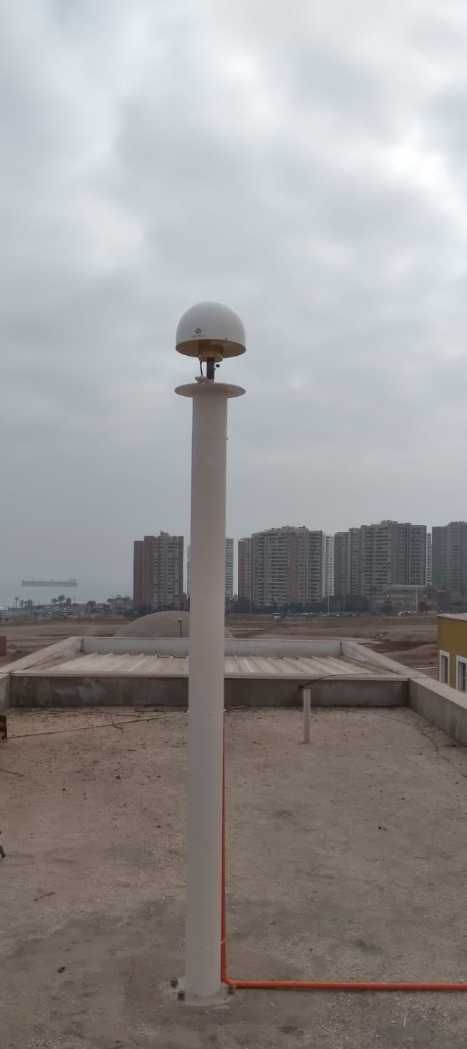
Chilean Mining. The context
MINING CODE 1983
MINING CODE REGULATIONS 1983
LAW 21420
REGULATIONS 2023…ON GOING
MINING CODE 1932
REGULATIONS | MINING CODE 1932 | MINING CODE 1983 | LAW 21420(2022)
Reference Frame | Topocentric coordinates | PSAD56-SAD69 | SIRGAS-REDGEOMIN
Coordinates System | abscissa axis according to astronomical meridian or magnetic north (plus declination) | UTM projection | UTM projection
Monumentation | Benchmark(Hito Referencia) +truncated pyramid (40cmx20cmx80cm) | Benchmark(Hito mensura)+Boundary(lindero) | CORS and digital cadastre
Status | Repealed | Repeal underway | on going
The first law in Chile that
includes SIRGAS as RF
North UTM
West UTM
Notes:
Modificar

Slide 6
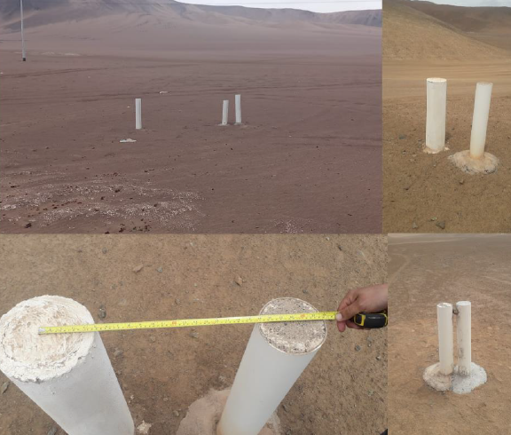
Chilean Mining. The problematic
The geodetic measurements of PSAD56 and SAD69 were made in the 50s to 70s by the IGM (Military Geographic Institute) and IAGS (Inter-American Geodetic Survey) of the United States.
In Chile, the transformation parameters between classic and modern RF, like SIRGAS, are made available only for cartography, scale 1:25000. The accuracy is ± 17 m (according to EPSG).
Since 1970 happened in Chile, several earthquakes have deteriorated the classics RF at the metric level.
Currently, PSAD56 and SAD69 are classic reference frames without maintenance by the IGM.
PSAD56 and SAD69 do not consider Chile's crustal deformation
The current modern RF for Chile (SIRGASChile) is a SIRGAS densification at the observation epoch (2002.00,2010.00, 2013.00, 2016.00, 2021.00). The transformations between these realizations have only parameters at the cartographic level (Rozas et al. 2021)
1 intersection with 3 or more boundaries
Due to the above, we have found in the field some intersections of two concessions that
does not materialise with one boundary but with several
Notes:
Modificar

Slide 7
Chilean Mining. Datum Update Project
OBJECTIVE:
To Implement a modern RF for Chile's mining, ideally a kinematic RF.
To calculate the optimal transformation parameters between classic (PSAD56-SAD69) and modern reference systems for mining in Chile. The parameters must maintain the mining concession's shape, size and orientation in the digital cadaster and must be unique for all of Chile without splitting the country.
STAGE 1:
Primary Geodetic Network (Active): Observation, calculation and adjustment of a national geodetic network compose exclusively with open-access CORS. The processing will be with IGS and SIRGAS standards, and the network name is REDGEOMIN (Red Geodésica para Minería EPSG:9694), in English Geodetic Network for Mining. Also, we perform a deformation model named ADELA: (Analysis of DEformation beyond Los Andes, 2009-2022)
STAGE 2:
Secondary Geodetic Network (Passive): New Coordinates are obtained tied to REDGEOMIN RF, and we measure with GNSS over the benchmarks of the primary network PSAD56-SAD69. The above allows getting coordinates couples in both systems for the next step.
STAGE 3:
Transformation parameters: Calculate the transformation parameters with the lowest RMS throughout Chile, which do not modify the concession's shape, orientation and size.
STAGE 4:
Commissioning of REDGEOMIN and parameters to implement the transition from PSAD56-SAD69 to REDGEOMIN. Beginning of LAW 21420
2018
2018-2022
2019-2022
2022
2023-xxxx
Sec.1.3 Pag.7
Notes:
Modificar

Slide 8
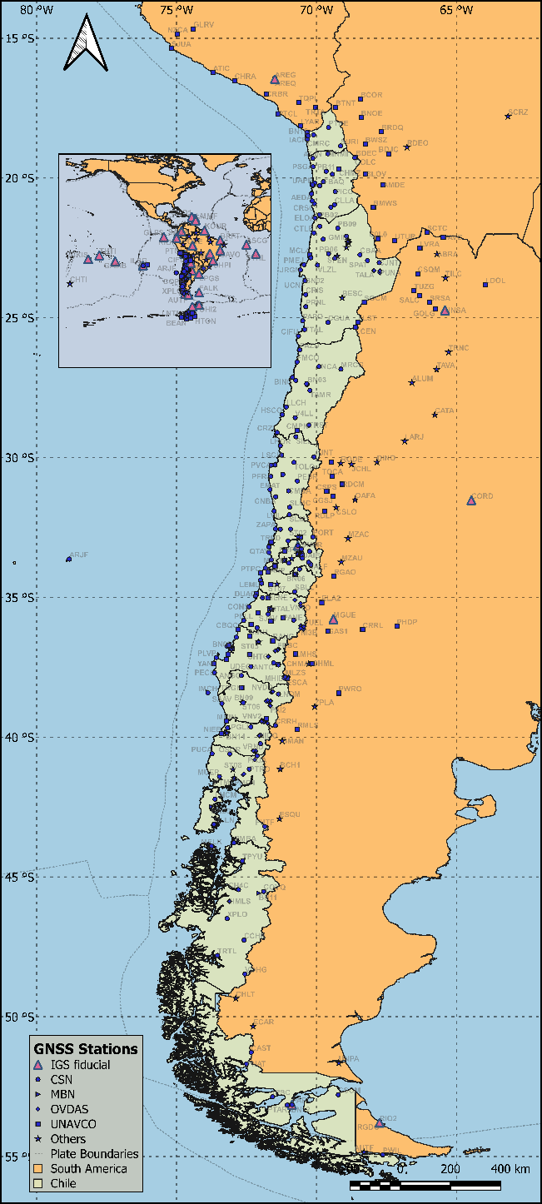
Transitioning form classic RF to modern RF. Geodetic Networks
Primary Geodetic Network (Active): REDGEOMIN (Red Geodésica para Minería), in English Geodetic Network for Mining
Data from 390 CORS in Chile and 30 around Chile
Processing with IGS and SIRGAS standards:
7 Daily solutions combined(ADDNEQ BSW 5.2 Dach et al., 2015), in 1 weekly solution: coordinates aligned to IGS reference frame (minimal constrained solutions)
The first four weekly solutions were:
REDGEOMIN@2019.00
REDGEOMIN@2020.00
REDGEOMIN@2021.00
REDGEOMIN@2022.00
Weekly station position repeatability
 | E (mm) | N (mm) | h (mm)
2019.00 | 1.59 | 1.60 | 3.64
2020.00 | 1.89 | 2.27 | 4.90
2021.00 | 2.23 | 2.21 | 5.26
2022.00 | 2.01 | 1.89 | 5.05
Sec.2.1 Pag.8
Notes:
C

Slide 9
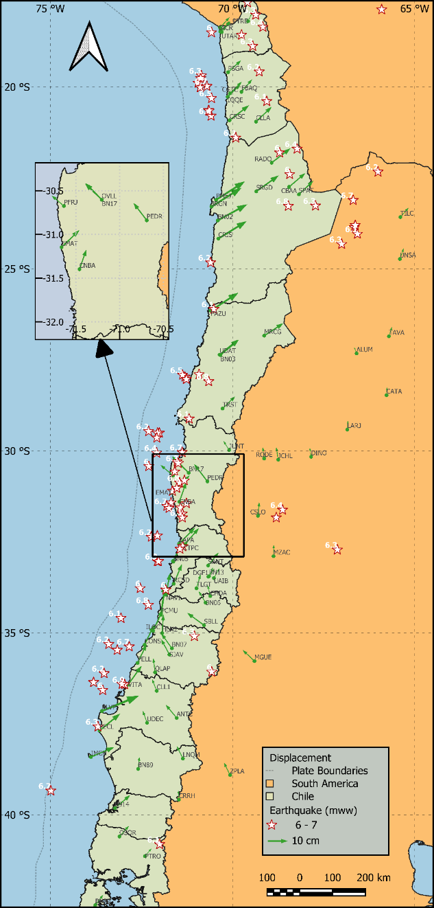
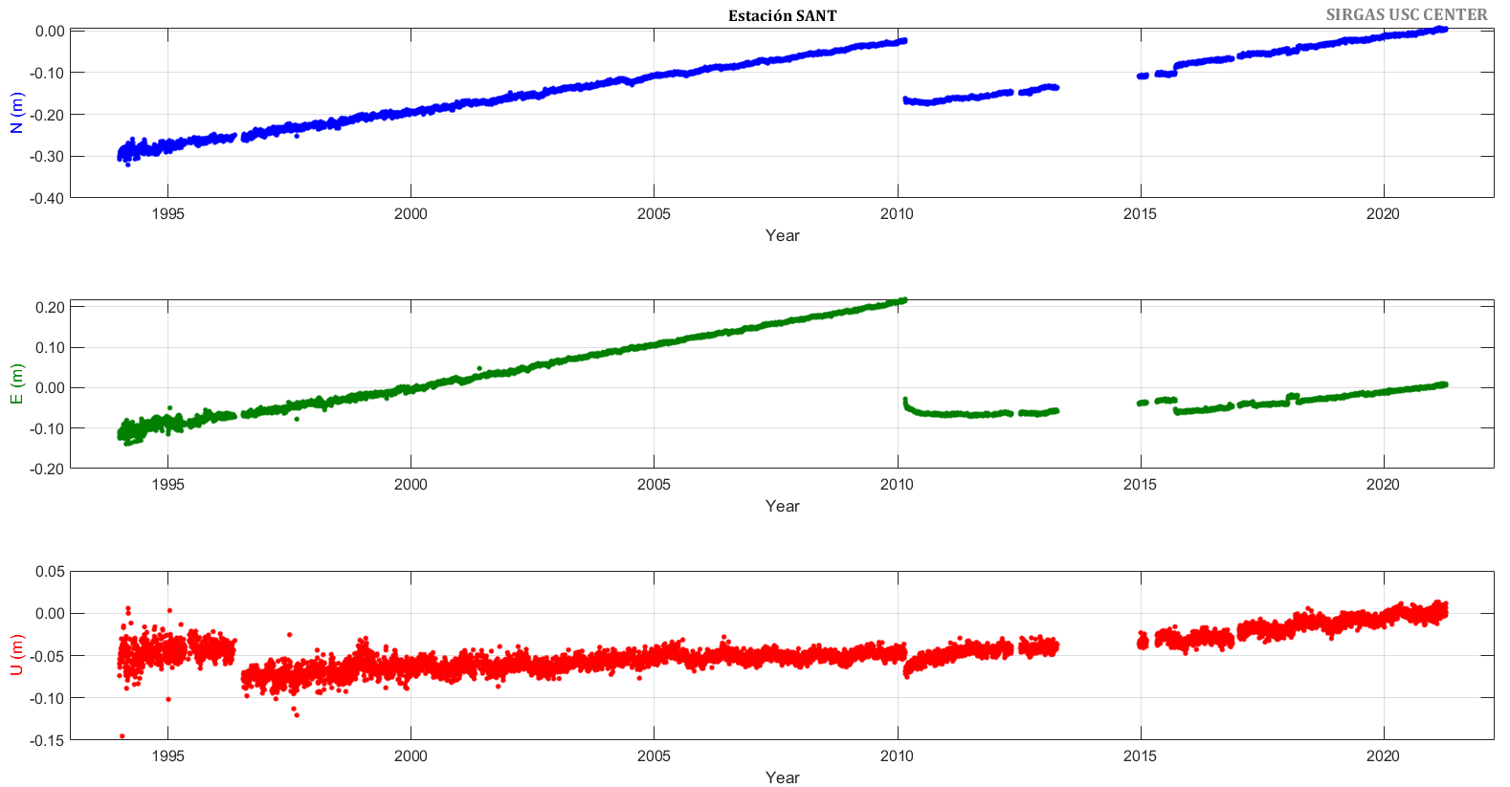
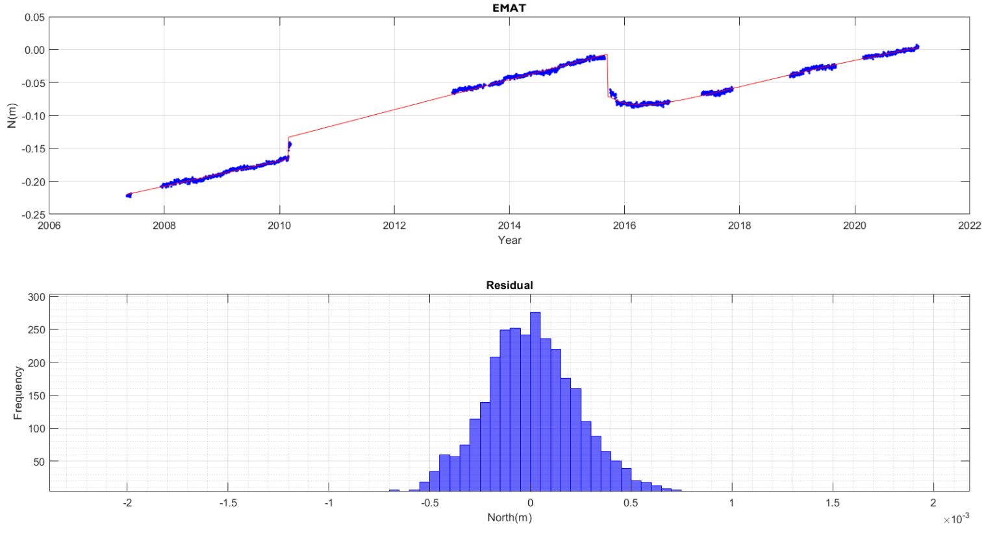
Transitioning form classic RF to modern RF. Deformation Model
We perform a weekly GNSS processing with data from open data GNSS stations, in the period 2022 to 2009, in the project called ADELA: (Analysis of DEformation beyond Los Andes). The functional model of the time series for ADELA is the following:
The GNSS time series was a highly complex aspect of this study since due to Chile's particularity, the station's movement cannot be reconstructed with lineal time series [Sánchez et. al 2020].
For this, a joint model is needed that takes into account the interseismic, coseismic, and postseismic periods. We modelled a postseismic with postseismic deformation model (PSD) that describes the period after the earthquake combining logarithmic and exponential functions [Sobrero et. al 2020].
The left map detail shows the station’s displacements from 2016 to 2021 in the north-central zone of Chile, with movements in a northeast direction in the north and with an "S" -shaped movement in the central zone marking the complexity of behaviour.
In the right image, the stations PFRJ, OVLL, BN17, and PEDR indicate an NW movement, while the movement 50 km to the south is in a NE direction.
This aspect has been a challenge for the deformation model, where the spatial correlation is low.
Sec.2.1 Pag.9
Notes:
The above opens the line of research to study displacements instead of the time series themselves [14], something that we are currently researching.

Slide 10
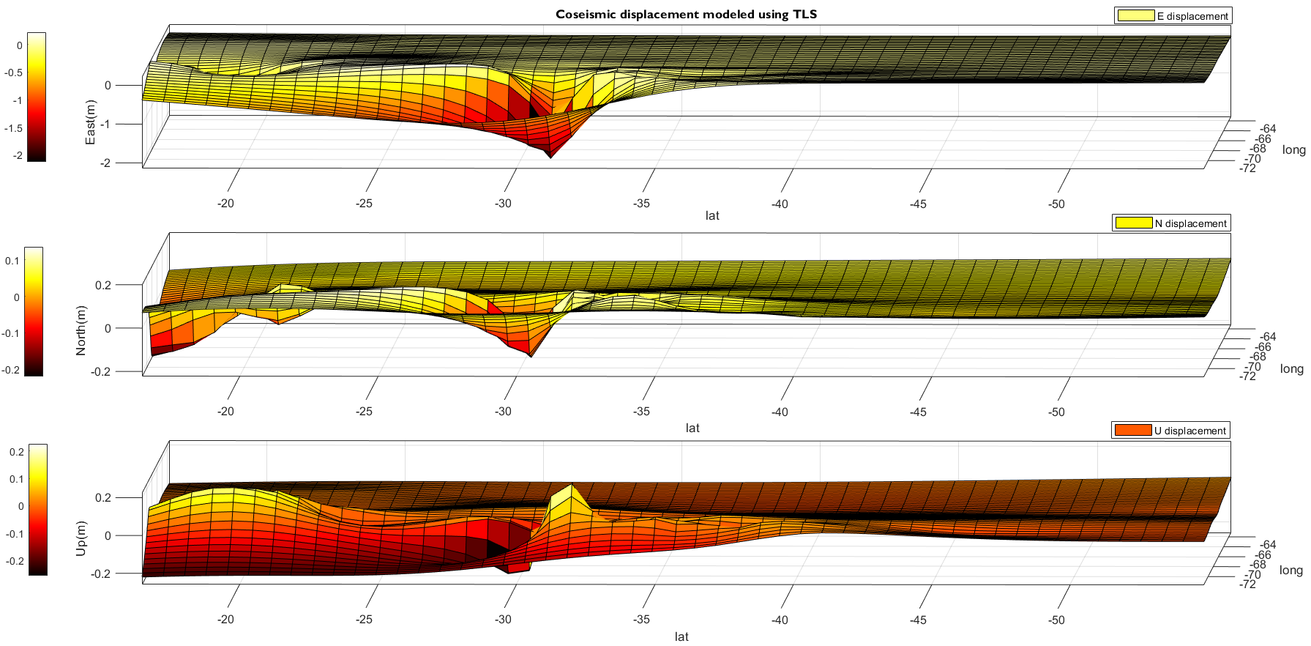
Transitioning form classic RF to modern RF. Deformation Model
We present a deformation model which is divided into three parts: interseismic, coseismic (fig 10b) and post-seismic(10a) components.
Figure 10b shows the displacement in coseismic model for Coquimbo (8.3 Mw) and Iquique (8.2 Mw) earthquakes
We hypothesise that the positions of the stations have an error smaller than that of the final model. Data from the GNSS stations are used exclusively, interpolating what happens between them only with geodetic data.
We want to provide a new point of view using a thin plate spline interpolation(TPS) (Fig 10c); Cross-validation was performed by complementing our data with Precise Point Positioning (PPP) information from Nevada Geodetic Laboratory (NGL). The results of the cross-validation of data show a μ = 0.0001 m and a σ = ± 0.005 m
fig 10a
fig 10b
fig 10c
Sec.2.1 Pag.10
Notes:
C

Slide 11
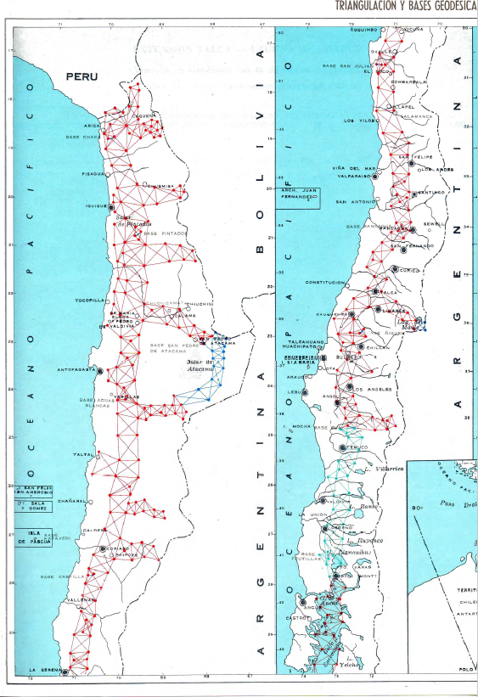
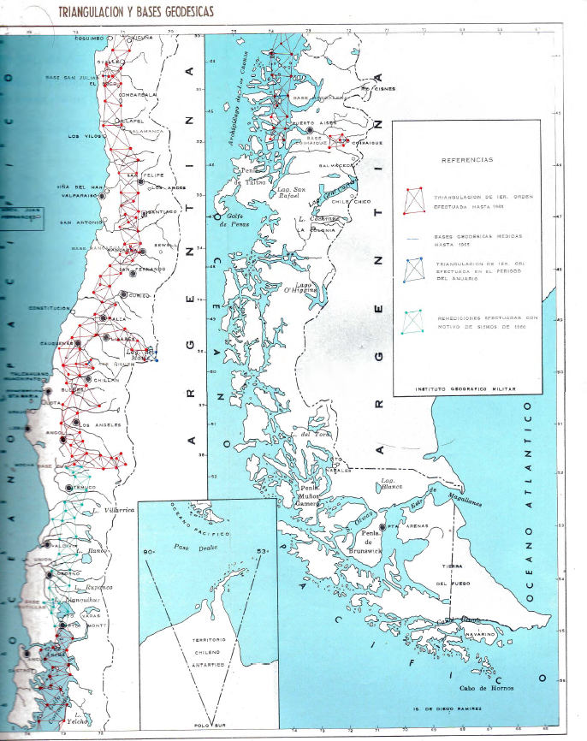
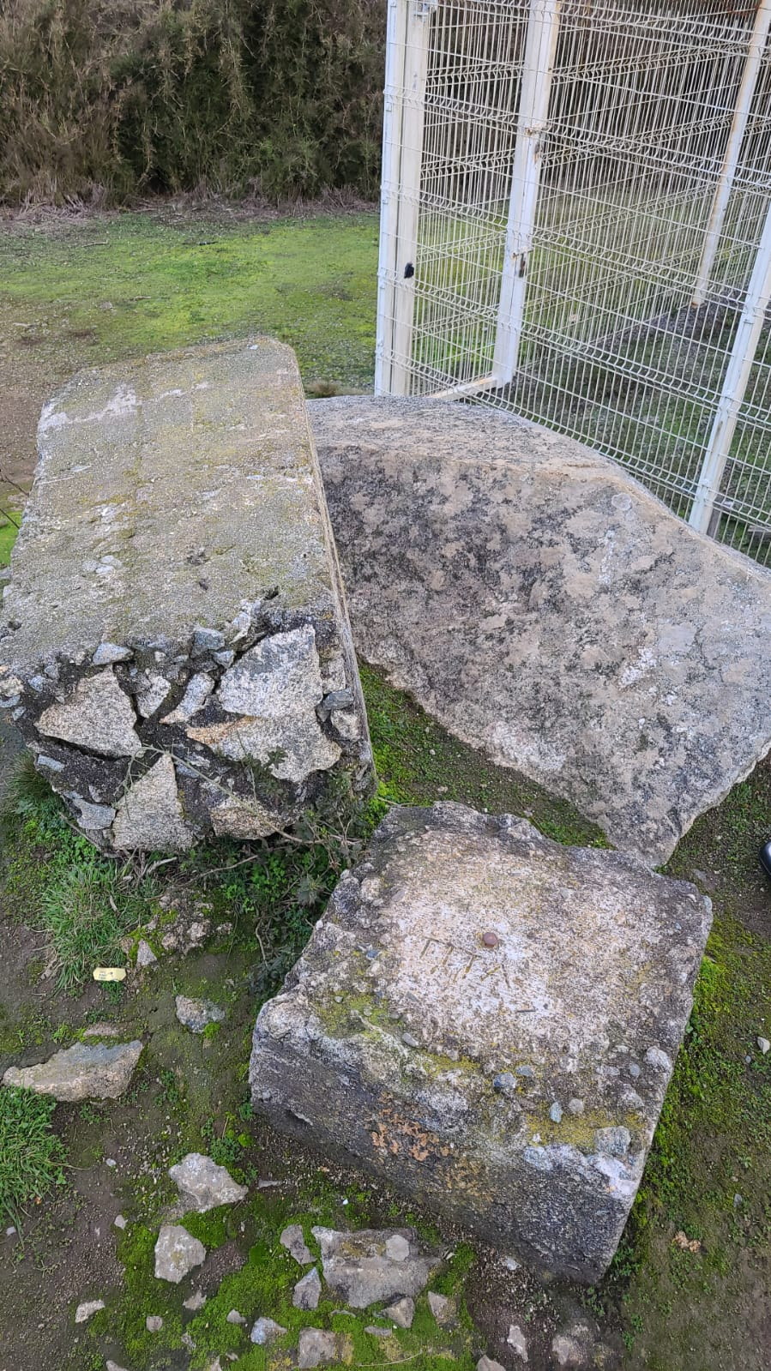
Transitioning form classic RF to modern RF. Secondary Network
To relate both systems, we need updated coordinates in the modern system on the PSAD56-SAD69 benchmarks.
Currently, the classic network(left image) is not maintained, so a review of the IAGS-IGM database is made to select native benchmarks that can be measured with GNSS.
We measure with GNSS over the benchmarks of the primary network PSAD56-SAD69(right image):
Selected #217
Measured #158
Destroyed #39
Inaccessible #20
We check outliers by contrasting (geodetic increments) the coordinates in the two systems.
There are 10 benchmarks with wrong PSAD56/SAD69 coordinates. We eliminated those coordinates.
There are two zones (Atacama and Central Region) with different deformations to those of the other parts of the country.
Results: Secondary Geodetic Network @2022.00 (Passive): REDGEOMIN
Parameter type | Used Parameter
Solution: | fixed phase ambiguities
Observable | GPS, GLONASS
Elevation Mask | 10º
Orbits: | IGS Precise Orbits
Processing interval: | 1 seg
Schütz et al. 2017
original triangulation network, (Maturana et. al 2005)
Sec.2.2 Pag.11
Notes:
C

Slide 12
Transitioning form classic RF to modern RF. Transformation Parameters
Objective:
To calculate the optimal transformation parameters between classic (PSAD56-SAD69) and modern reference systems for mining in Chile. The parameters must maintain the mining concession's shape, size and orientation in the digital cadaster and must be unique for all of Chile without splitting the country.
Two approaches:
we assess a classical transformation for the whole country, and another through grid offsets(NTv2)
2d with only with translations for to avoid the mining concession's deformation
Total Control Points | 157 | 157 | 157 | 157 | 157
Selected Control Points | 108 | 89 | 57 | 38 | 143
Total Control Points | 134 | 134 | 134 | 134 | 23 | 134 | 134 | 134
Selected Control Points | 116 | 97 | 72 | 46 | 16 | 11 | 10 | 7
Total Control Points | 20 | 157 | 157 | 157 | 157
Selected Control Points | 15 | 12 | 11 | 6 | 15
Sec.2.3 Pag.12
Notes:
C

Slide 13
Next steps. Implementation
According to the case of Iceland, to implement a modern RF, it is necessary to consider (Pascal Kierulf et al. 2019)
Deformation models with sufficient accuracy to meet the future require comparison and compiling coordinates from different epochs.
Geodetic data archives can store and handle kinematic coordinates.
A way to distribute the reference frame to the users, e.g. positioning services.
Transformations to other reference frames.
The legal foundation of kinematic reference frames (e.g., cadastre).
Training and education of surveyors.
Training and education of GIS users.
A sufficiently dense active geodetic infrastructure, like Continuous Operating Reference Stations (CORS) with known coordinates in a global reference frame (e.g. ITRF).
GIS systems can handle general kinematic coordinates, the time dimension of a kinematic RF, and the various transformations needed.
The users' willingness to use such a system.
Sec.3.1 Pag.13
Notes:
C

Slide 14
Thank you very much
Transition from PSAD56/SAD69 to SIRGAS.
Toward a kinematic reference frame for mining in Chile
José Antonio Tarrío Mosquera^{1x}, Jesarella Inzunza Muñoz¹, Catalina Caceres Venegas¹, Marcelo Caverlotti Silva¹ ,Valeria Vásquez Tejo¹, Fernando Isla Rodríguez¹, Gabriel Jeldres², Rodrigo Urrutia², Cristian Mardones²
¹Centro de Procesamiento y Análisis Geodésico USC
Universidad de Santiago de Chile
2Servicio Nacional de Geología y Mineria. Chile
IAG International Symposium on Reference Frames for Applications in Geosciences (REFAG 2022), Aristotle University of Thessaloniki,
Commission 1,International Association of Geodesy (IAG). Thessaloniki, Greece on October 17-20, 2022

