Slide 1
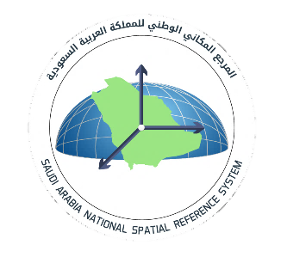
Reference Frames for Applications in Geosciences 2022 (REFAG),
17-20 October, 2022
THESSALONIKI, GREECE
Saudi Arabia National Spatial Reference System - SANSRS
A.Alqahtani, R. Grebenitcharsky, S.Alshahrani, I.Golubinka, M.Alqarni and S.Alqurashi
General Authority of Survey and Geospatial Information (GASGI),
Saudi Arabia

Slide 2
2
Outline
National Geodetic Infrastructure
Saudi Arabia National Spatial Reference System Components
National geodetic reference frame KSA-GRF17
KSA-CORS network and primary geodetic network
National Vertical Reference Frame KSA-VRF14
National Vertical Network (NVN)
National Gravity Network (NGN) and gravity observations on NVN benchmarks
National Vertical Datum – 3d
Current KSA-GEOID17
Airborne Gravity
GPS/GNSS for ellipsoidal height determination over Saudi Arabia
New KSA-Geoid Development
Role of 3D KSA-Vertical Datum as a link between KSA-GRF & KSA-VRF
Transition from Static to Dynamic/Time Varying Reference System
Conclusions and Recommendations

Slide 3
1
National Geodetic Infrastructure

Slide 4
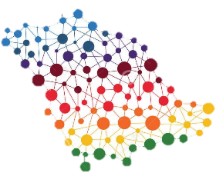
National Geodetic Infrastructure
It is combination of Spatial Reference System and Geodetic Networks which contribute in establishing and supporting positioning applications in horizontal and vertical directions with high quality & accuracy and national coverage
It is considered the foundation of National Spatial Data Infrastructure (NSDI)
National Geodetic Networks
National Spatial Reference System
Reference Frames for Applications in Geosciences 2022 (REFAG)

Slide 5
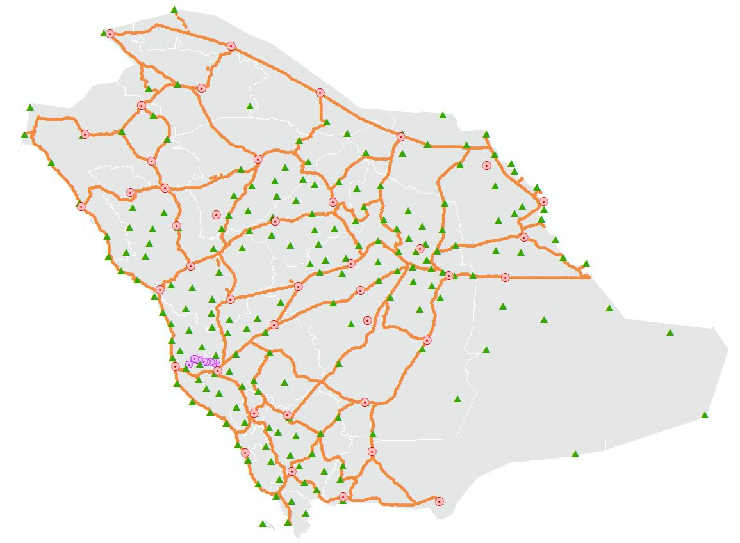
National Geodetic Networks
They are a group of different geodetic networks – major components KSA-GRF and KSA-VRF - which were established to provide the necessary geodetic data for different projects and land surveying activities in KSA.
National Geodetic Networks were established based on International Standards
209
CORS
3893
BM
National CORS Network
National Vertical Network
3893
Relative Gravity
41
Absolute
Gravity
14
Gravity Calibration Base line
National Gravity Network
National Geodetic Networks
National Spatial Reference System
Reference Frames for Applications in Geosciences 2022 (REFAG)

Slide 6
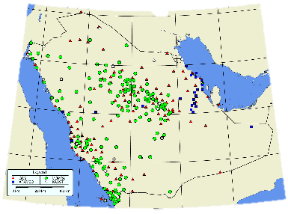
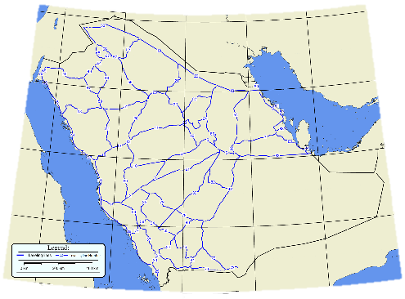
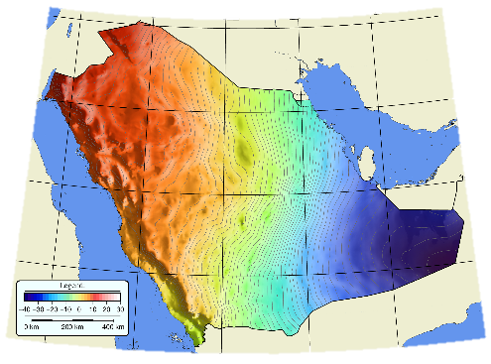
National Spatial Reference System
Spatial Reference System (SRS) is a regional or global reference system which is used in all positioning applications in both dimensions - horizontal and vertical - and also all existing geo-spatial products are reference to it.
these geodetic components are defined based on data and information from different geodetic networks.
National Geodetic Reference Frame (NGRF)
National Vertical Reference Frame (NVRF)
National Geoid Model
National Geodetic Networks
National Spatial Reference System
Reference Frames for Applications in Geosciences 2022 (REFAG)

Slide 7
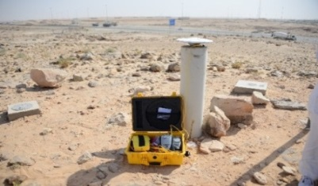
National Geodetic Infrastructure
National Geodetic Infrastructure
National Geodetic Reference Frame (NGRF)
National CORS Network
National Vertical Reference Frame (NVRF)
National Geodetic Networks
National Spatial Reference System
National Geoid Model
National Vertical Network
National Gravity Network
National Tide Gauge Network
Geodetic Network
Reference Frames for Applications in Geosciences 2022 (REFAG)

Slide 8
2
Saudi Arabia National Spatial Reference System Components

Slide 9
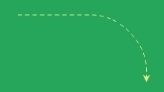
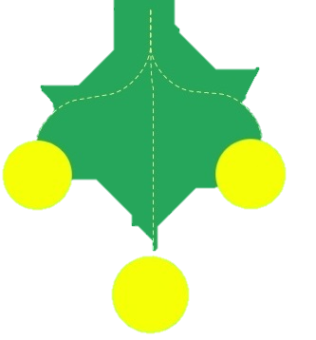
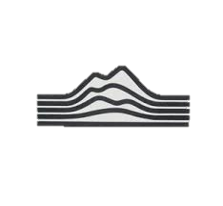
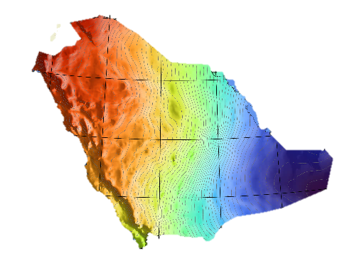
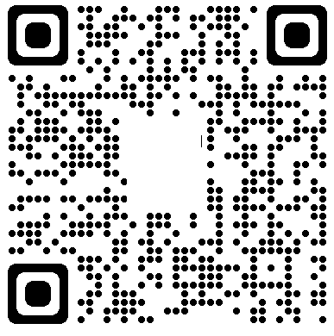
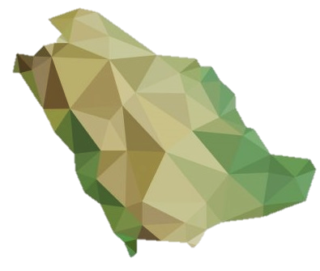
9
National geodetic reference frame KSA-GRF17
National Vertical Datum – 3d
National Vertical Reference Frame KSA-VRF14
KSA-CORS network and primary geodetic network
Current KSA-GEOID17
National Vertical Datum (NVD) – 1d
National Gravity Network (NGN)
National Vertical Network (NVN)
Airborne Gravity
GPS/GNSS for ellipsoidal height

Slide 10
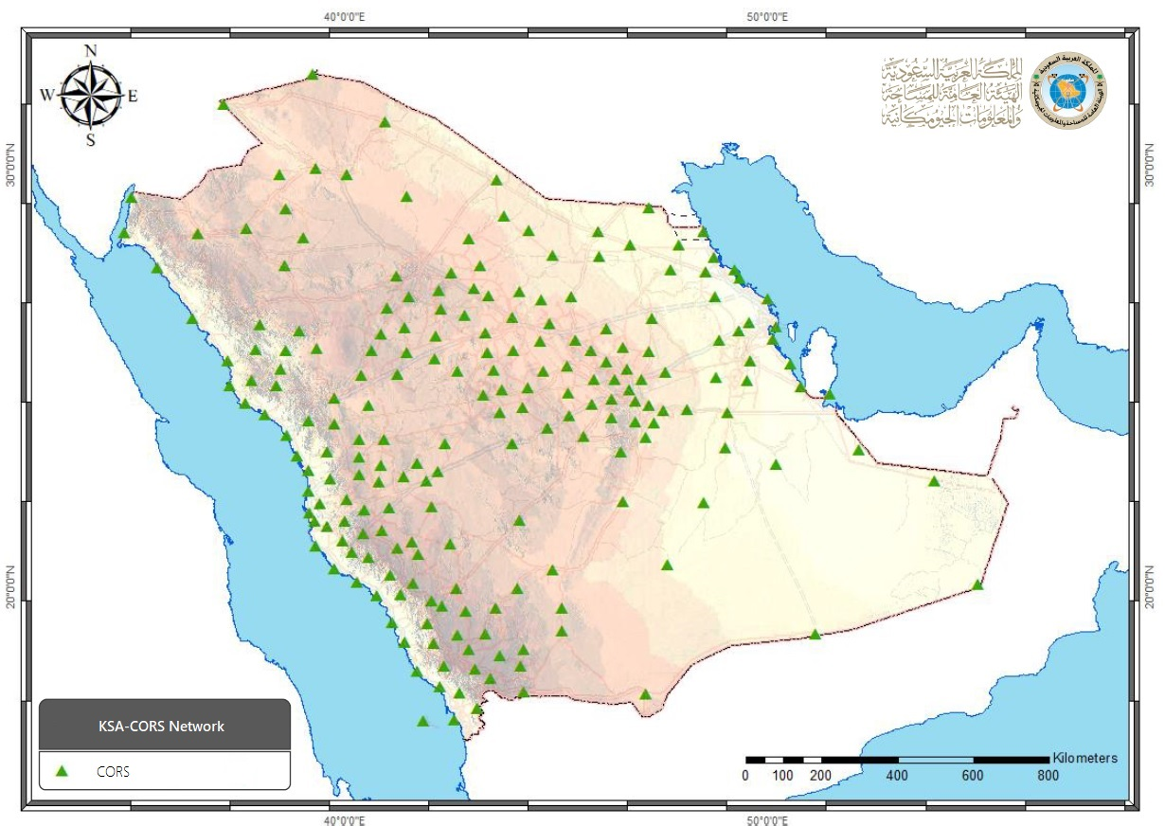
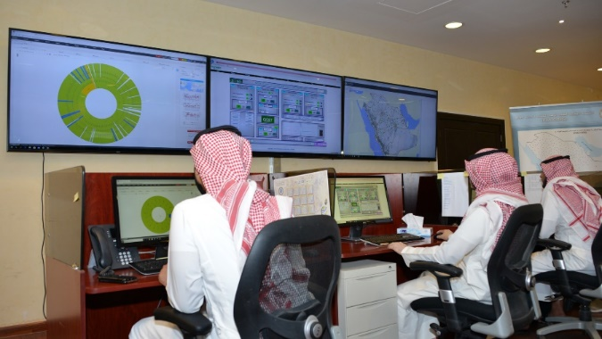
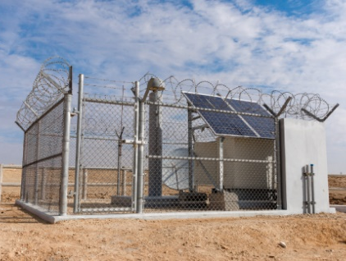
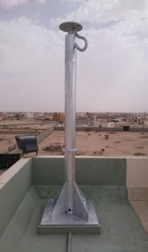
National Geodetic Reference Frame KSA-GRF17
KSA-CORS network - the core of KSA-GRF17 Dissemination
Planned
313
CORS
Network Control Center (NCC): to control and monitor KSA-CORS network.
Current
209
CORS
Ground type (GT) & Roof type (RT): for SANSRS definition & precise positioning services
Reference Frames for Applications in Geosciences 2022 (REFAG)

Slide 11
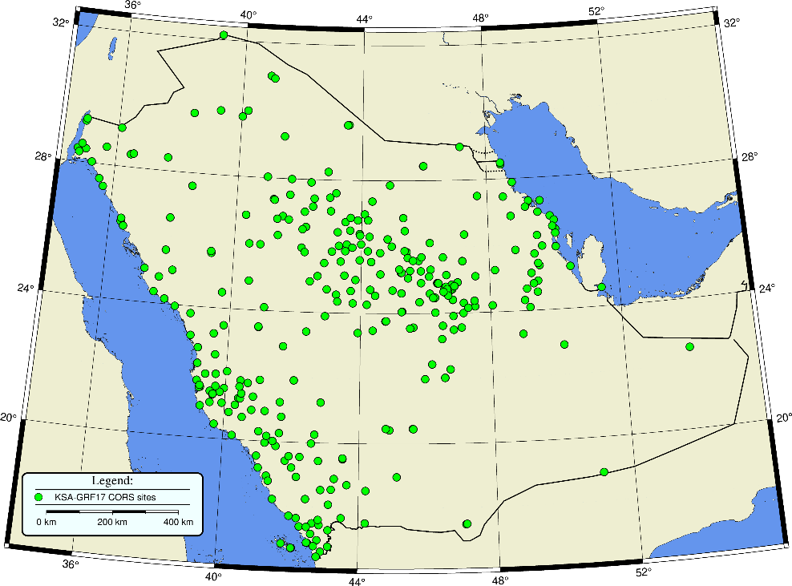
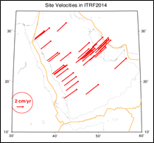
National Geodetic Reference Frame KSA-GRF17
KSA-GRF17
The Kingdom of Saudi Arabia established the unified National Geodetic Reference Frame KSA-GRF17.
KSA-GRF17 was computed based on ITRF2014/IGS14 epoch 2017.0. using observations of 51+14 IGS stations used also in definition of ITRF2014.
Defined in such way that: it coincides with ITRF2014 at epoch 2017.0.
it is moving consistently with the stable part of the Arabian tectonic plate.
general transformation formula linking KSA-GRF17 to the ITRF2014, for station positions is given by the following equation:
$${\left(\begin{aligned}X \\ Y \\ Z\end{aligned}\right)}_{KSAGRF17}\left(t\right)={\left(\begin{aligned}X \\ Y \\ Z\end{aligned}\right)}_{ITRF2014}\left(t\right) + \left(\begin{matrix}0 & {−\dot{R}}_{z} & {\dot{R}}_{y} \\ {−\dot{R}}_{z} & 0 & {−\dot{R}}_{x} \\ {\dot{R}}_{y} & {\dot{R}}_{x} & 0\end{matrix}\right)×{\left(\begin{aligned}X \\ Y \\ Z\end{aligned}\right)}_{ITRF2014}\left(t\right).\left(t−2017.0\right)$$
For station position at any epoch $t$:
where: Rx, Ry, Rz are the three components of the Arabian plate rotation pole (or angular velocity) expressed in ITRF2014.
Reference Frames for Applications in Geosciences 2022 (REFAG)

Slide 12
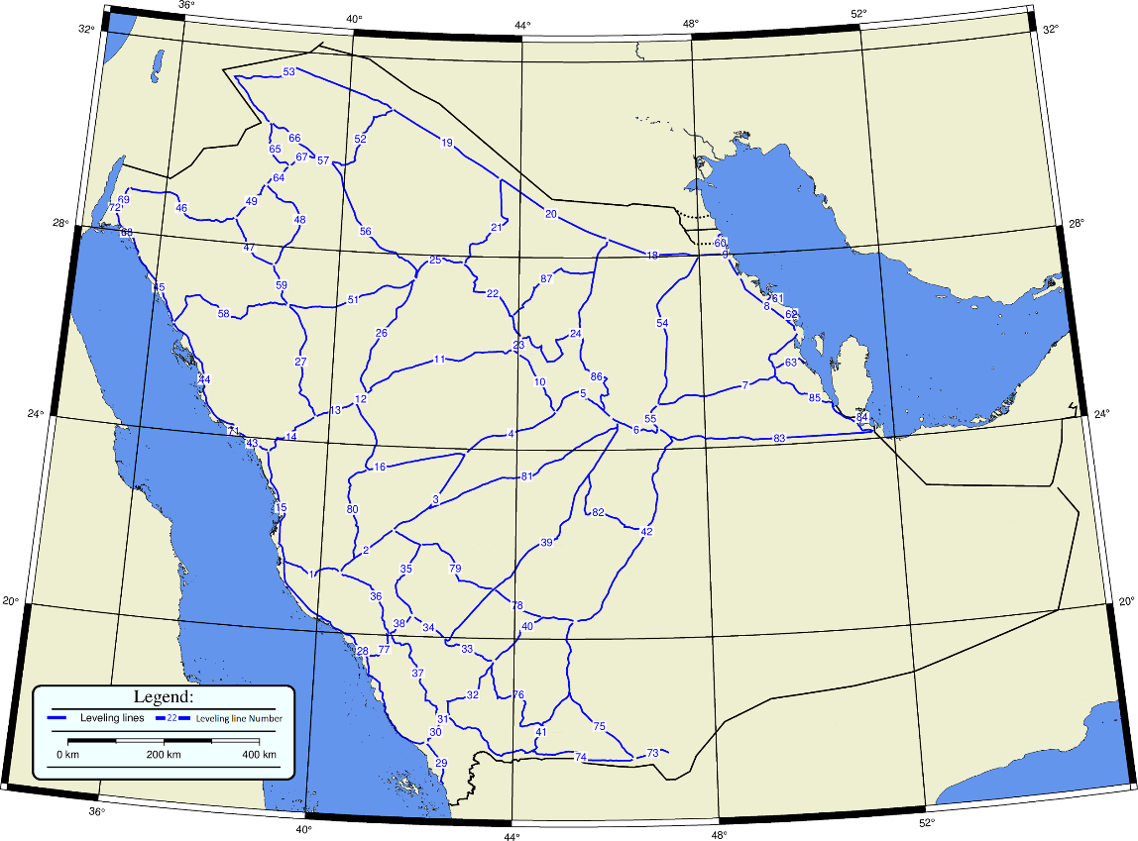
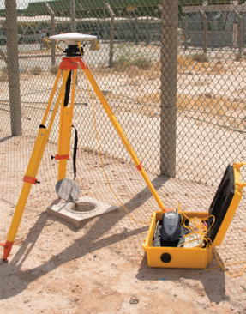
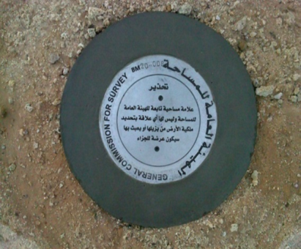
National Vertical Reference Frame KSA-VRF14
National Vertical Network (KSA-NVN)
Main task
Provide a precise and unified vertical datum for Orthometric heights determination over the KSA.
KSA-NVN
Number of BMs: 3893;
Number of level lines: 88;
Distance between the BMs: 6 km;
Total length of NVN: 22869 km;
The a priori accuracy - NGS standards for Second order/Class I double run precise geodetic leveling.
The provisional accuracy for double run - for entire NVN ±1.03 mm/km.
NVN has an accuracy better than
Second order/Class I according to NGS Standard
Reference Frames for Applications in Geosciences 2022 (REFAG)

Slide 13
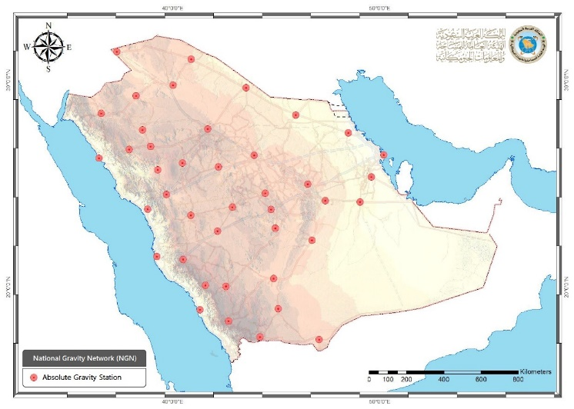
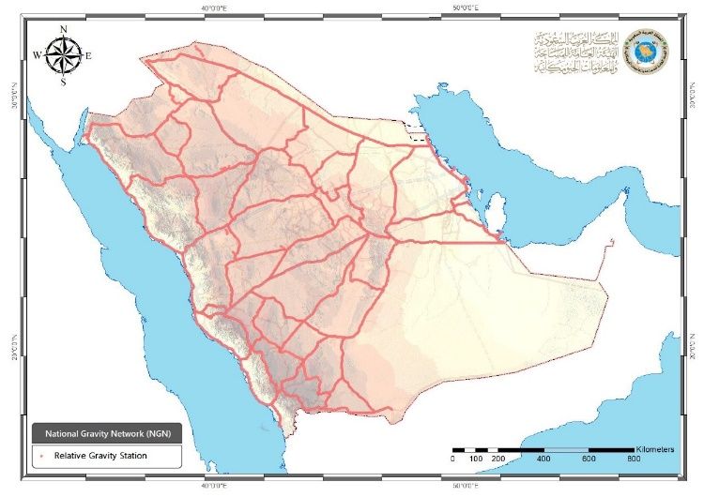
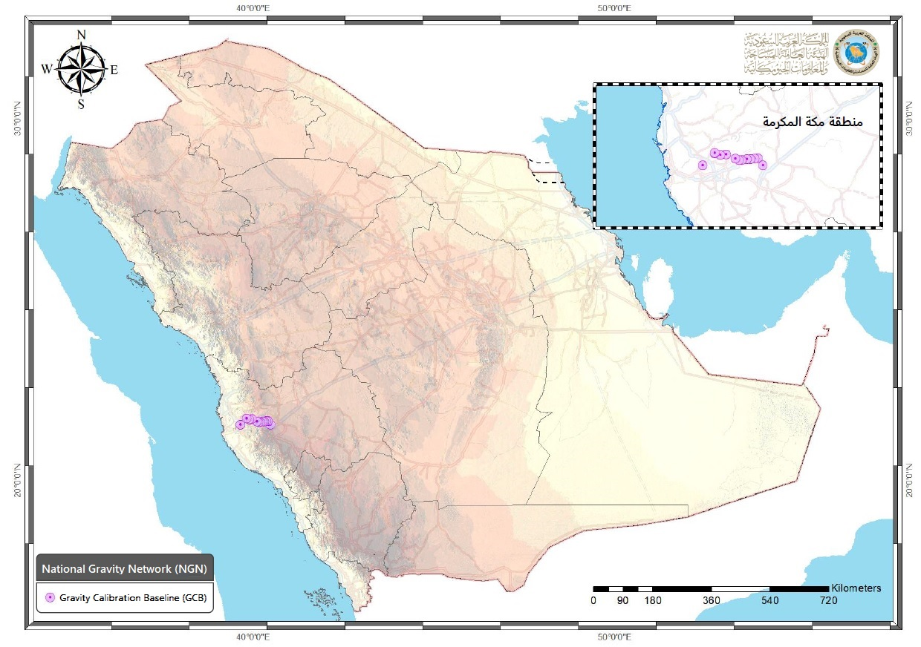
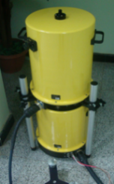
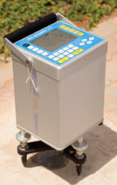
National Vertical Reference Frame KSA-VRF14
National Gravity Network (NGN) and Gravity Observations On NVN Benchmarks
Main task
to establish gravity reference system of KSA as part of the SANSRS and to support the realization of gravity standard over the KSA
NGN class 1: gravity base network (GBN) - absolute gravity observations on 41 stations with center and ex-center points;
NGN class 2:
Primary Relative Gravity network (PRGN) - densification of the absolute gravity sites (mostly 250 BMs from KSA-NVN apart each other 60 km);
National vertical network gravity measurements at BMs, TG BMs and PGNs (3504);
Service: Gravity Calibration Baseline (GCB) – 14 AG (with center and ex-center points) with achieved average accuracy for relative gravity values: 1.2 μGal (center points); 1.6 μGal (ex-center points). And relative gravity linking them
NGN has an accuracy better than
Second order/Class I according to NGS Standard
Reference Frames for Applications in Geosciences 2022 (REFAG)

Slide 14
National Vertical Reference Frame KSA-VRF14
Ksa-vrf14
KSA Vertical Reference Frame Jeddah’2014
KSA-VRF14 is based on in-situ observations from tide gauge stations, precise levelling, gravity data, satellite altimetry and GOCE data.
KSA-VRF14 is the latest realization of National Vertical Reference System (NVRS). The main characteristics of KSA-VRF14 are as follows:
​Height system type: | ​Helmert-orthometric Above Mean Sea Level at JEDDAH Tide Gauge
​Least-Square Adjustment type: | ​Fixed geo-potential number above MSL of Jeddah TGBM-B
​Physical Realization Benchmarks: | ​National Vertical Network
​Physical Realization Grid Interpolation: | ​KSA-GEOID17/KSA-GRF17
​Tidal system: | ​Tide Free
​Primary Benchmark: | ​Jeddah TGBM-B
​Latitude: | ​21.49981 [degree]
​Longitude: | ​39.16161 [degree]
​Fixed height above Mean Sea Level of Jeddah TGBM-B | ​1.7446 [m]
​Epoch: | ​2014.75 year
Reference Frames for Applications in Geosciences 2022 (REFAG)

Slide 15
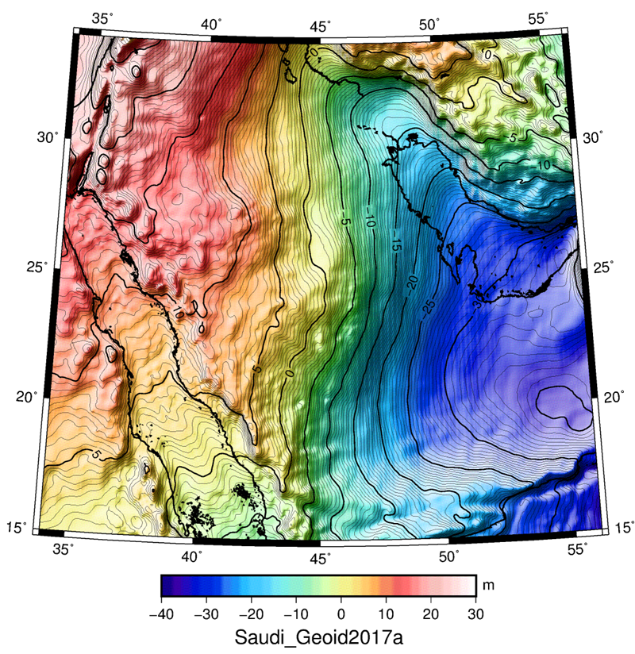
National Vertical Reference Frame KSA-VRF14
National Vertical Datum – 3d
Current KSA-GEOID 17
The current KSA-GEOID 17 model is based on a gravimetric geoid, which is utilizing:
EGM EIGEN6C4 reference field (incorporating GOCE and GRACE satellite data);
New DTU15 satellite altimetry data offshore;
More than 500 000 gravity data points from both new (GASGI) and older (ARAMCO) data sources;
The geoid is fitted to the KSA-VRF14 through a set of 280 GPS/levelling points along the NVN
Geoid accuracy:
better than 2 cm in area with gravity data
15-20 cm in areas without gravity data and gravity related information
Reference Frames for Applications in Geosciences 2022 (REFAG)

Slide 16
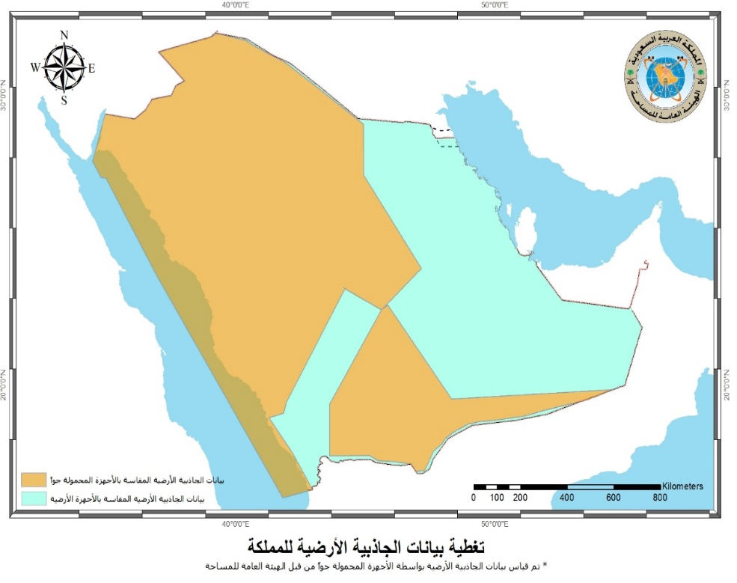
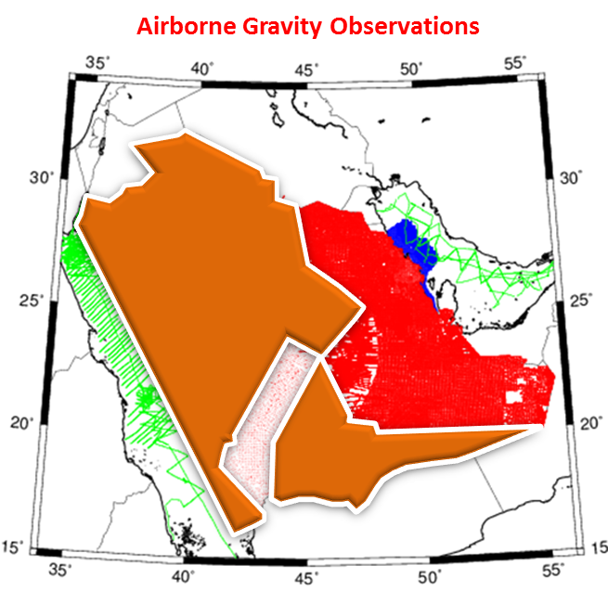
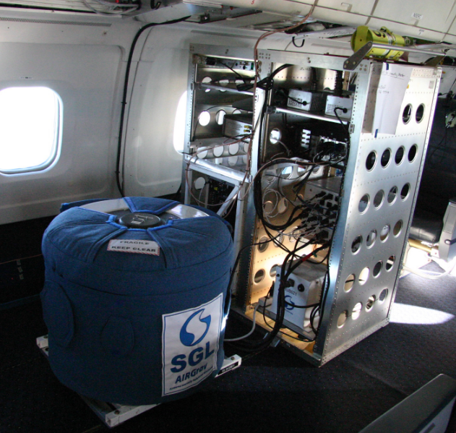
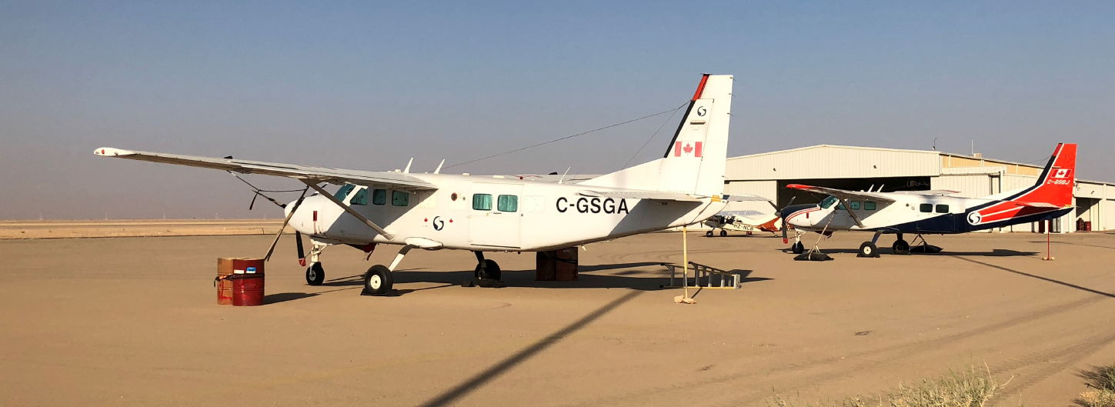
National Vertical Reference Frame KSA-VRF14
National Vertical Datum – 3d
Airborne Gravity
Main task
New gravimetric KSA- GEOID to be computed by filling large gaps with centimeter Accuracy:
Survey area coverage: ~1.320.000 square km;
Accuracy: ~0.7 μGal
Airborne Gravity coverage
Reference Frames for Applications in Geosciences 2022 (REFAG)

Slide 17
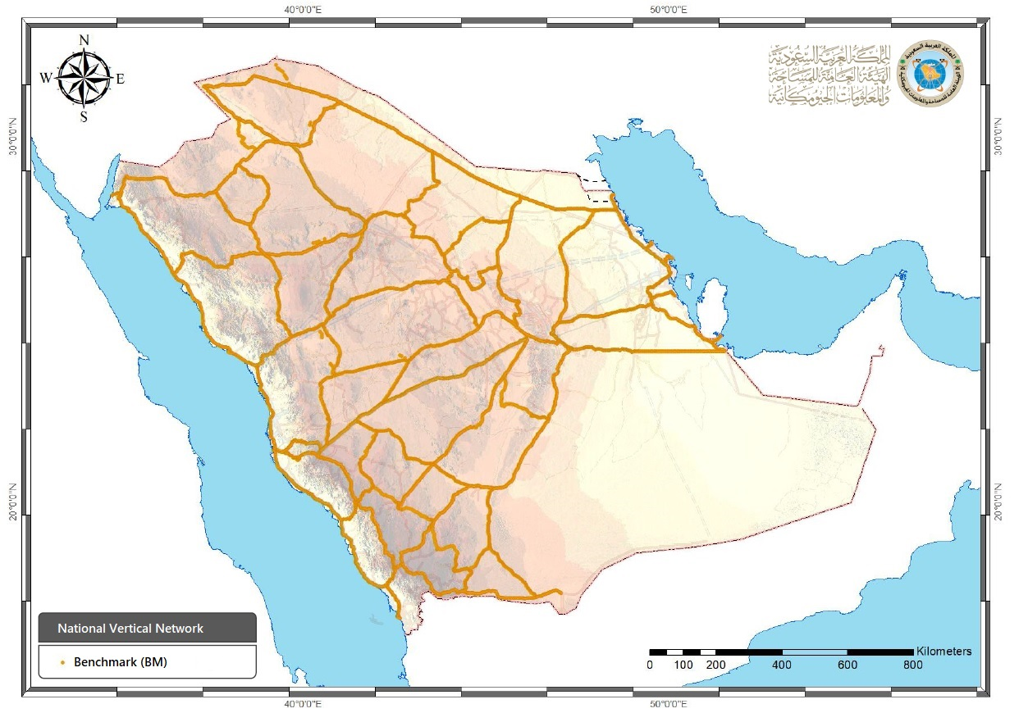
National Vertical Reference Frame KSA-VRF14
National Vertical Datum – 3d
GPS/GNSS For Ellipsoidal Height Determination Over KSA
Main task
to determine ‘hybrid’ KSA-GEOID;
The KSA-VRF needs to be utilized over the territory of KSA by application of GPS/GNSS/leveling technique providing ellipsoidal height with better than 2 cm-accuracy;
The current regional model of the kingdom fitted to GPS/GNSS/leveling data linked to KSA-VRF14 and KSA-GRF17;
Observation coverage: entire NVN, TG networks, absolute gravity stations and gravity calibration baseline
Outputs: Ellipsoidal height of all BMs, TG, AG Stations and GCB with better than 2 cm
Reference Frames for Applications in Geosciences 2022 (REFAG)

Slide 18
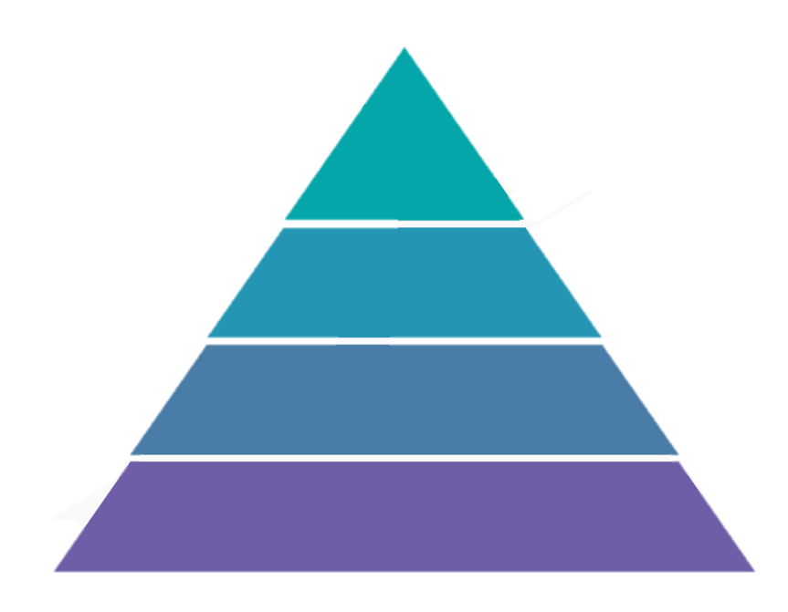
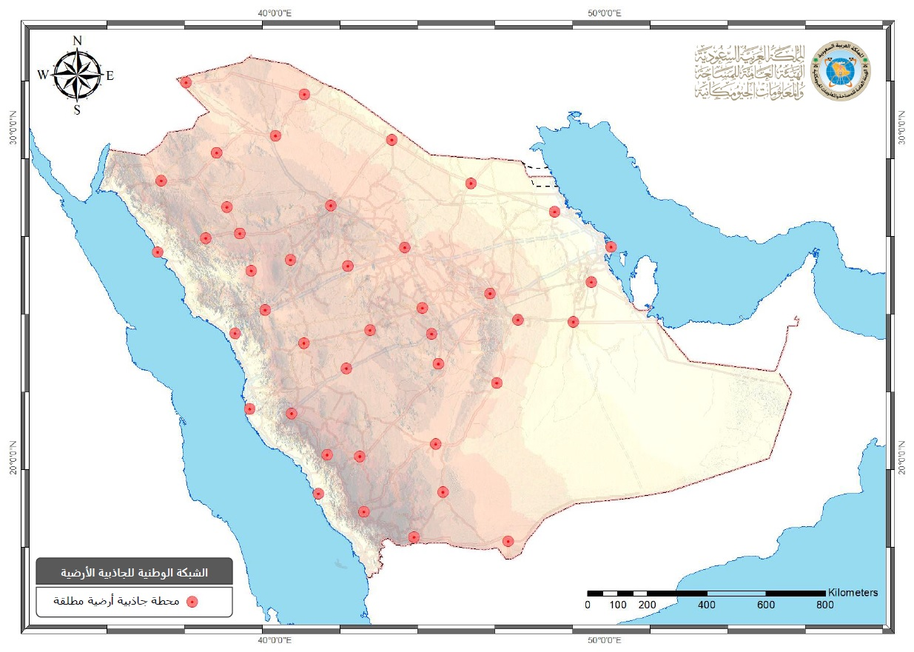
National Vertical Reference Frame KSA-VRF14
National Vertical Datum – 3d
KSA-GEOID21 (New KSA-Geoid)
Main task
Determination of a new high-accuracy (1-2 cm) and high-resolution gravimetric geoid model over the territory of KSA
Determination of a new high-accuracy (1-2 cm) and high-resolution hybrid geoid model over the territory of KSA
Gravity (Land, Marine, Airborne)
GPS/Levelling
GGMs DTM/DEM
New
KSA-GEOID21
Reference Frames for Applications in Geosciences 2022 (REFAG)

Slide 19
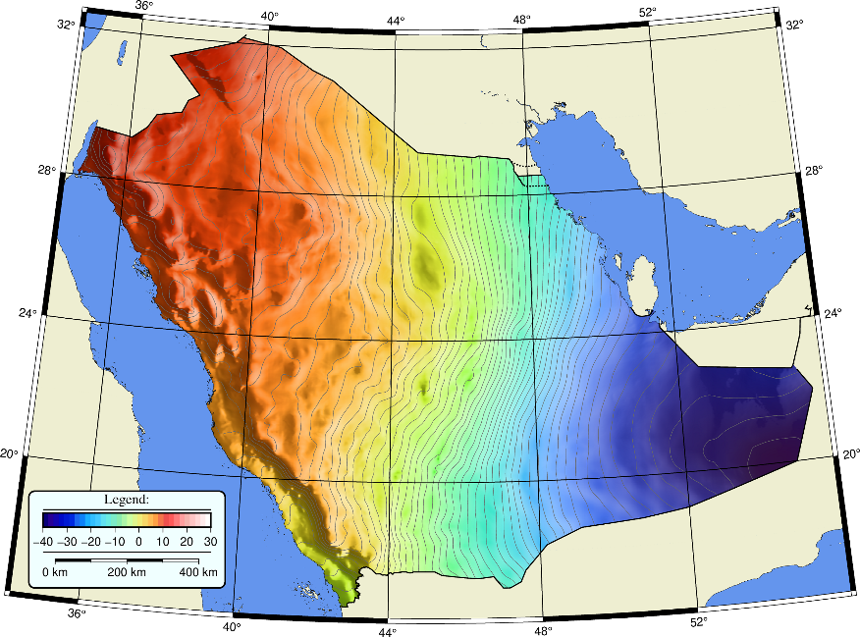
National Vertical Reference Frame KSA-VRF14
Role of 3D KSA-Vertical Datum
KSA-GEOID: Link between KSA-GRF & KSA-VRF
Reference Frames for Applications in Geosciences 2022 (REFAG)

Slide 20
Transition from Static to Dynamic/Time Varying Reference System
Currently, GASGI is working on developing a concept for transition from static to dynamic/time varying SANSRS & the following SANSRS components will be considered:
Transition of KSA Geodetic Reference Frame (KSA-GRF) - from static reference frame w.r.t. to Arabic plate to reference frame including inter-plate and areas with natural & technogenic motions
Transition of KSA Vertical reference frame (KSA-VRF)
National Tide Gage Network (TGN) -monitoring the effect of Mean Sea Level and its rate on changes in geo-potential of TG stations
National Vertical Network (NVN) – monitoring the effect of geometric movements of Tide Gauge stations, Ground CORS stations and specific areas of interest (Tectonic and technogenic active zones, seismic active, subsiding areas and etc.) on geo-potential changes and separation of pure geometrical movements from physical gravity field changes;
Transition of KSA Geoid
National Gravimetric Network – campaign based and permeant Absolute gravity observation
Time varying gravity field from old, current and future satellite gravity mission
Dynamic KSA Geoid – determination and validation
Developing new geodetic earth observation applications over KSA (InSAR, SLR, VLBI and etc.), supporting the transition to time varying SANSRS and those utilizing it
The Concept of transition from static to dynamic/ Time varying SANSRS - part of the National Geodetic Program (NGP), currently under development by GASGI- GDG
Reference Frames for Applications in Geosciences 2022 (REFAG)

Slide 21
3
Conclusions and Recommendations

Slide 22
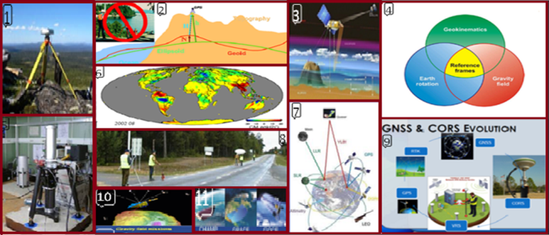
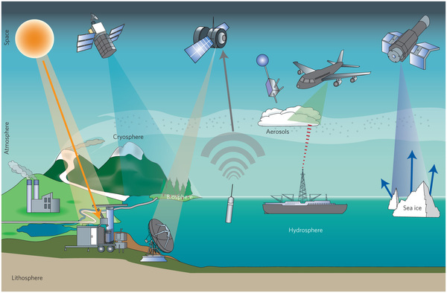
Conclusions and Recommendations
All geodetic activities at General Authority of Survey and Geospatial Information (GASGI), and its up to date infrastructure can be considered as a very good background start, which could support different geodesy-linked activities:
KSA-GRF/KSA-VRF/KSA-GEOID is the common geodetic infrastructure for applications linked to Geo-referencing, the Earths’ gravity field, geophysics, oceanography, hydrography, hydrology, water flow studies, surveillance of coastal areas and etc.
General and specific issues regarding future cooperation with different governmental/international organizations, professional and scientific communities – geodetic data and information stack holders.
Different forms of cooperation between GASGI and other communities can be established –multi-partner working groups.
Different joint activities (workshops, seminars, common projects and etc.) during major conferences and meetings can be planned.
GEODETIC APPLICATIONS
Geodetic data and information stack holders
in Future; SANSRS includes transforming from Static (3D) to Dynamic (4D) System, which will allow any product, service or application described time wise.
http://www.nature.com/nclimate/journal/v3/n10/full/nclimate1908.html
Reference Frames for Applications in Geosciences 2022 (REFAG)

Slide 23
Reference Frames for Applications in Geosciences 2022 (REFAG),
17-20 October, 2022
THESSALONIKI, GREECE
Thanks for Your Attention!

