Slide 1
Consistency of Galileo Satellite Antenna Phase Center Offsets
P. Steigenberger, O. Montenbruck
REFAG 2022

Slide 2
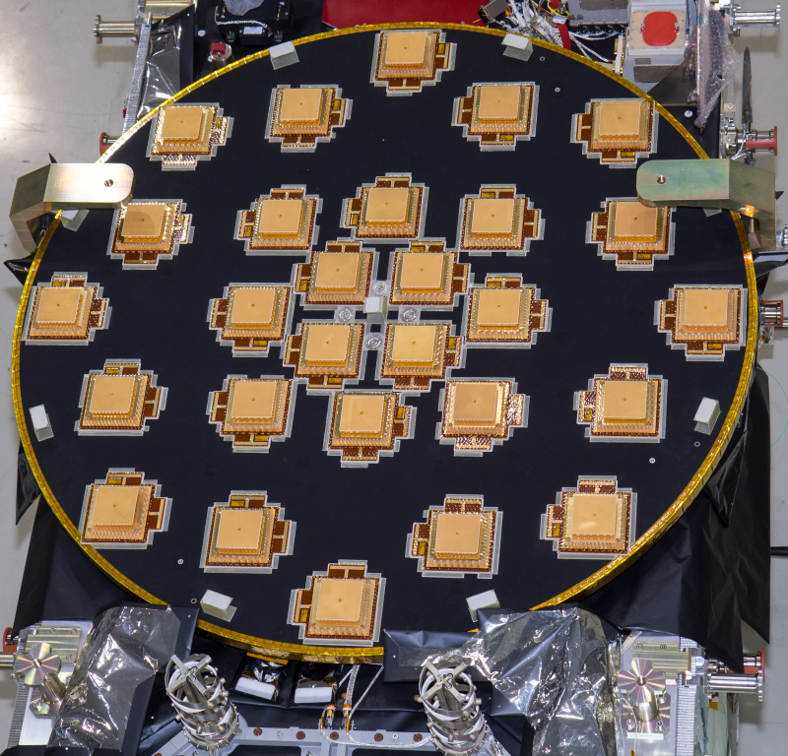
Motivation
Galileo satellite antenna phase center calibrations published by EUSPA
E1/E5a used as default within IGS
Growing number of E5b- and E6-capable receivers
Inconsistencies in BDS-3 B1I/B3I and B1C/B2a antenna calibrations identified by Zajdel et al. (2022)
Are the Galileo calibrations consistent?
© ESA-Anneke Le Floc'h

Slide 3
Satellite Antenna Phase Center Offsets
Mean Phase Center
Current definition as used in IGS ANTEX:
PCO: vector from the center of mass to the mean phase center
Satellite antenna Z-PCOs are correlated with the terrestrial scale
PCO
z_{IGS}
y_{IGS}
Center-of-Mass

Slide 4
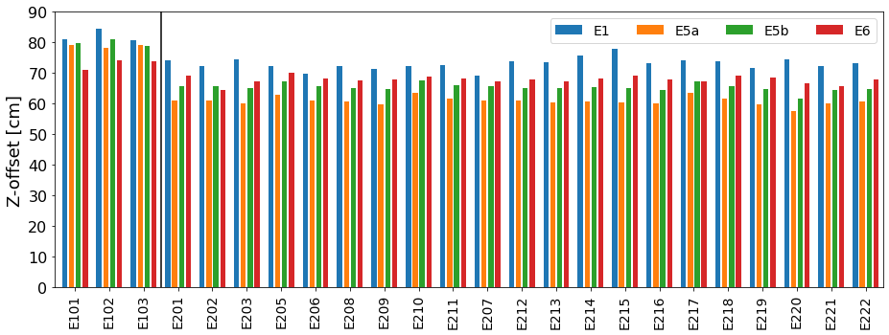
Galileo Satellite Antenna Phase Center Offsets
Obtained from chamber calibrations Available for E1, E5a, E5b, E5, E6
IOV
FOC

Slide 5
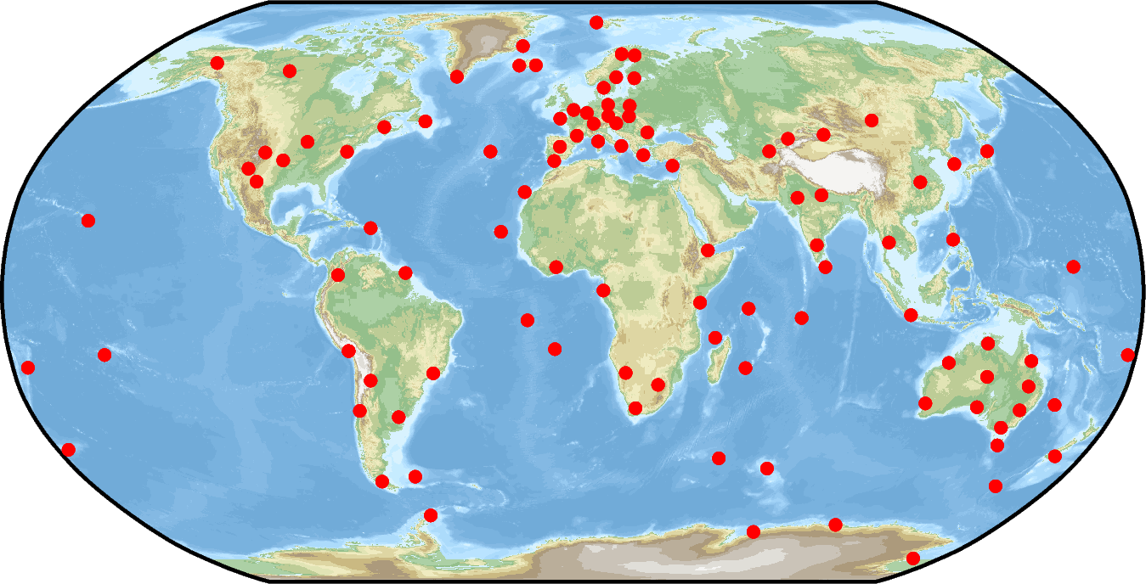
GNSS Data Processing
Station Selection
Multi-frequency receiver antenna calibration
Tracking of GPS L1/L2 and Galileo E1/E5a/E5b/E6
Global distribution
Global GPS+Galileo solutions with NAPEOS
Estimation of station coordinates, troposphere zenith delays, ERPs, clocks, orbits, PCOs
ITRF2020 a priori coordinates
148 selected stations
1 July 2021 – 30 June 2022
Ionosphere-free linear combinations of E1/E5a, E1/E5b, E1/E6

Slide 6
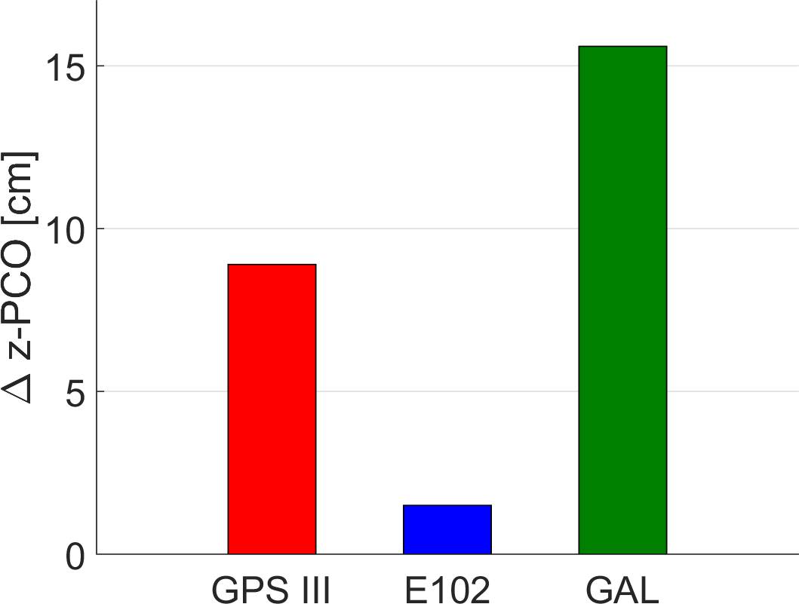
ITRF2020 and igs20.atx Z-PCOs
ITRF2020 scale:
Average of SLR and VLBI
0.15 ppb offset SLR/VLBI
0.68 ppb offset of IGS/GNSS solution at epoch 2015.0
igs20.atx satellite antenna Z-PCOs
Scale consistent with ITRF2020 at epoch 2015.0
Single offset w.r.t. manufacturer values estimated for GPS III
Other GPS L1/L2 Z-PCOs estimated from Repro3 time series
Offset w.r.t. manufacturer values estimated for Galileo IOV satellite E102
Single offset w.r.t. manufacturer values estimated for other Galileo satellites
Notes:
Galileo: 15.6 cm
E102: 1.5 cm
GPS III: 8.9 cm

Slide 7
Horizontal Galileo PCOs
IOV: In-Orbit Validation FOC: Full Operational Capability FOCe: FOC in eccentric orbit (E201 and E202)

Slide 8
Horizontal PCOs: Differences Estimated and Calibrated

Slide 9
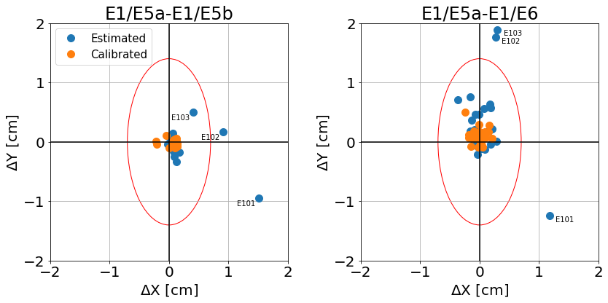
Horizontal PCOs: Differences Linear Combinations
Mean formal errors of PCO estimates

Slide 10
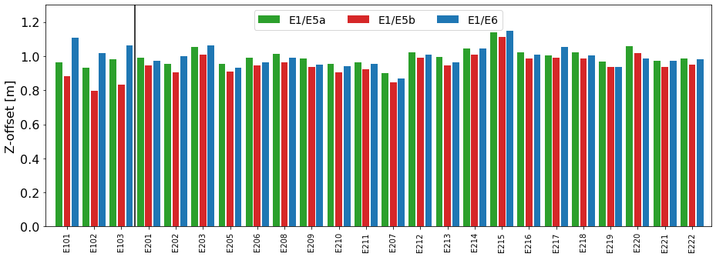
Estimated Galileo Z-PCOs

Slide 11
Z-PCOs: Differences Estimated and Calibrated

Slide 12
Mean PCO and Scale Differences
Semi-analytical relation between PCO and station height change:
for Galileo orbit height and 10°cutoff angle
Linear combination | ΔZ PCO [cm] |  | Scale difference [ppb/mm]
 | All | FOC | All |  | FOC
E1/E5a | -11.4 | -11.6 | 0.73 | 4.7 | 0.75 | 4.8
E1/E5b | -10.2 | -11.9 | 0.66 | 4.2 | 0.77 | 4.9
E1/E6 | -14.5 | -15.7 | 0.93 | 5.9 | 1.01 | 6.4
Notes:
Mean PCO differences [cm]
| Freq. | all | IOV | E101/3 | E102 | FOC |
| E1/E5a | -11.4 | -9.8 | -14.2 | -1.0 | -11.6 |
| E1/E5b | -10.2 | 1.7 | -2.5 | 10.1 | -11.9 |
| E1/E6 | -14.5 | -6.5 | -11.1 | 2.6 | -15.7 |

Slide 13
Consistency with igs20.atx (1)
estimated PCO,
ITRF2020 scale fixed
Galileo orbit
Calibrated PCO
igs20.atx PCO
Z-PCO
Galileo: 15.6 cm
Galileo: -1.7 cm
-2.4 mm/a PCO drift (Galileo)
+0.1 mm/a scale drift of igs20.atx
TRF Scale
ITRF2020 scale
2015.0
2022.0

Slide 14
Consistency with igs20.atx (2)
-0.7 cm 2.3 cm
10.9 cm 1.9 cm
2.6 cm -1.8 cm
Notes:
| Freq. | all | IOV | E101/3 | E102 | FOC |
| E1/E5a | 1.9 | -0.7 | -0.4 | -1.2 | 2.3 |
| E1/E5b | 3.1 | 10.9 | 11.4 | 9.9 | 1.9 |
| E1/E6 | -1.3 | 2.6 | 2.7 | 2.4 | -1.8 |

Slide 15
Summary and Outlook
Horizontal PCO estimates
agree within their estimation precision with the ground calibrations for FOC
Small discrepancy for IOV
Z-PCO estimates
10-16 cm discrepancy w.r.t. calibrations
±2 cm discrepancy w.r.t. igs20.atx
E1/E5a and E1/E5b FOC scale pretty consistent at 0.03 ppb level
0.25 ppb FOC difference for E1/E6
Increased differences for IOV, in particular for E1/E5b
Consistency of different frequencies better by a factor of two compared to BDS-3
Multi-frequency applications (raw approach, ambiguity resolution, ...)

